Slide 1
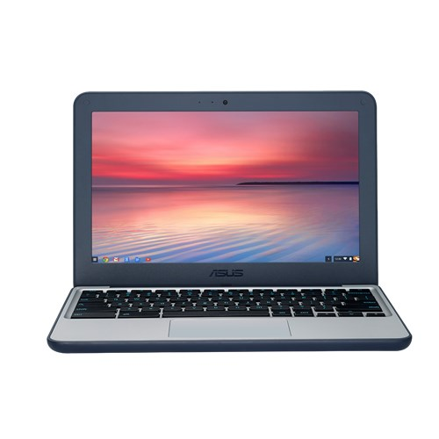
Chromebook Training

Slide 2
Please Be Quiet & Follow The Instructions
You are about to follow several important steps in order to learn how to use some of the key features of your Chromebook. Please be quiet, follow the instructions and do not jump ahead.

Slide 3
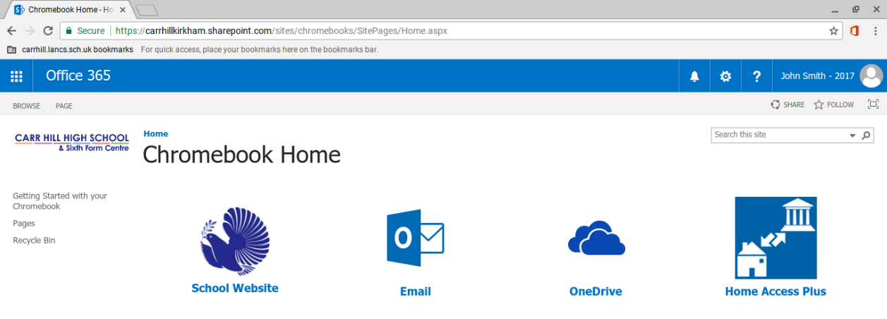
Using Office 365 On Your Chromebook
It is the Schools intention to use Office 365 primarily when using your Chromebook. Office 365 includes Email, OneDrive and online versions of Word, Excel and PowerPoint. All your work will be saved automatically to your OneDrive storage area.
From the Chromebook Home Page click OneDrive.

Slide 4
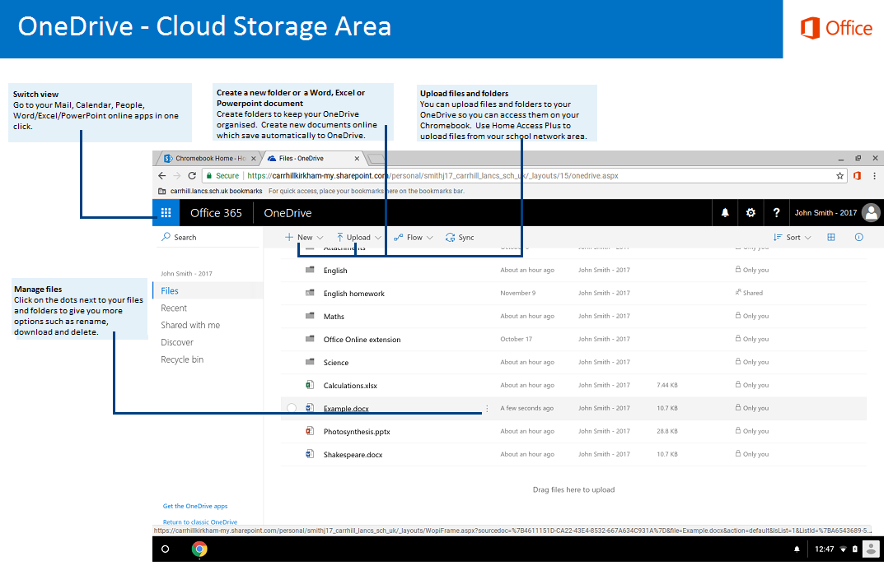

Slide 5
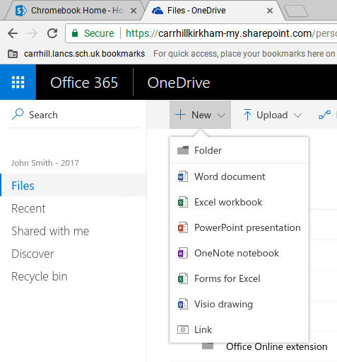
Creating Folders & Documents
You can create new folders to keep your files organised. You can also create a new Word, Excel or PowerPoint Document which will then open on the Chromebook and save automatically to your OneDrive.
Click New and then click Folder to create new folders. Create 3 new folders called English, Maths and Science.
Then click New again and click Word Document.

Slide 6
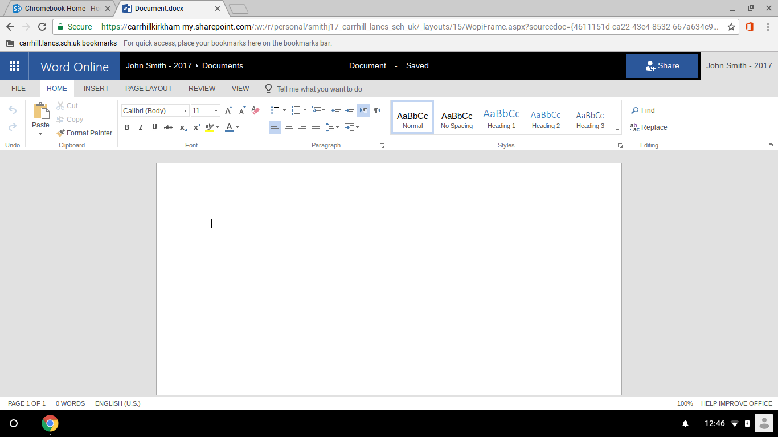
Create A Word Online Document
A new Word Online document will open. Type your name into this document.

Slide 7
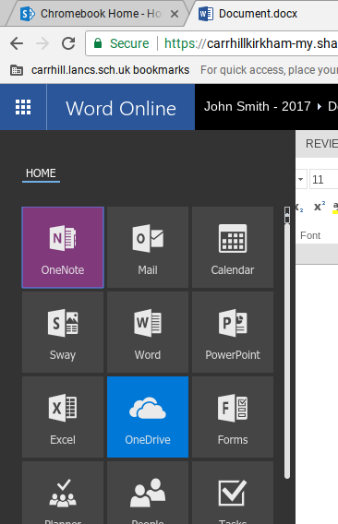
Name Your Document
You can name your document to give it a descriptive name. Click on the area that says Document and call it Example.
When you are finished working on your document return to OneDrive by clicking the icon in the top left corner and then click OneDrive.

Slide 8
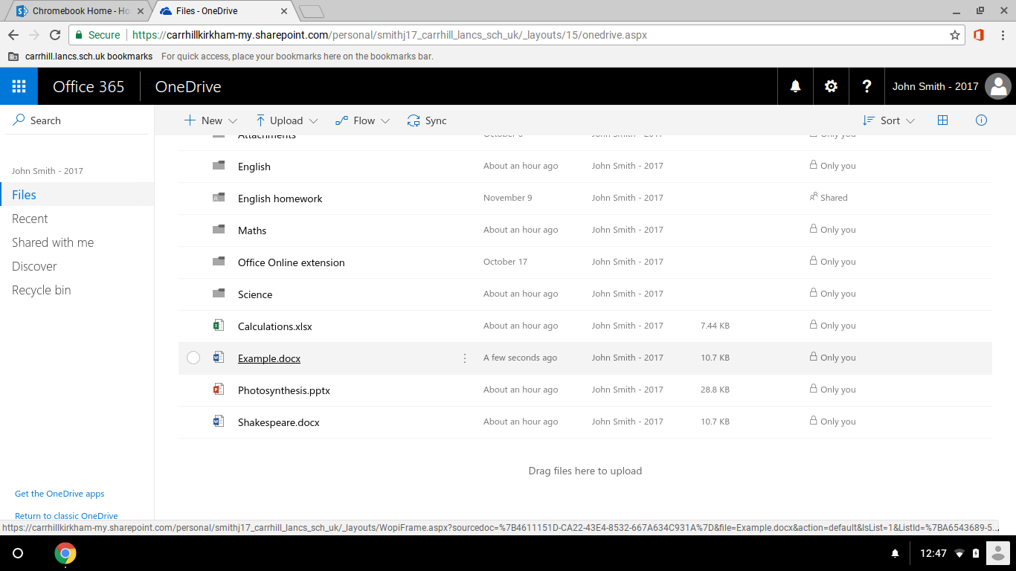
Opening Your OneDrive Files
Documents saved in your OneDrive can be re-opened by clicking on them.

Slide 9
Downloading & Uploading Files
We will now download some files from Home Access Plus and set these up so that they open in Office Online.
Home Access Plus allows students to access their School My Documents area from a Chromebook.
From the Chromebook Home Page click Home Access Plus and login with your username and password.

Slide 10
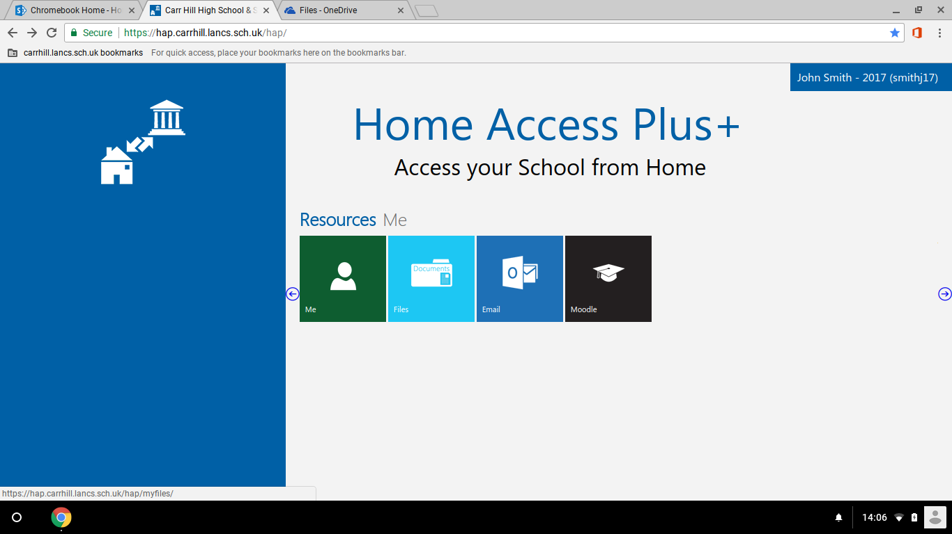
Downloading & Uploading Files
On the Resources page click the Files icon.

Slide 11
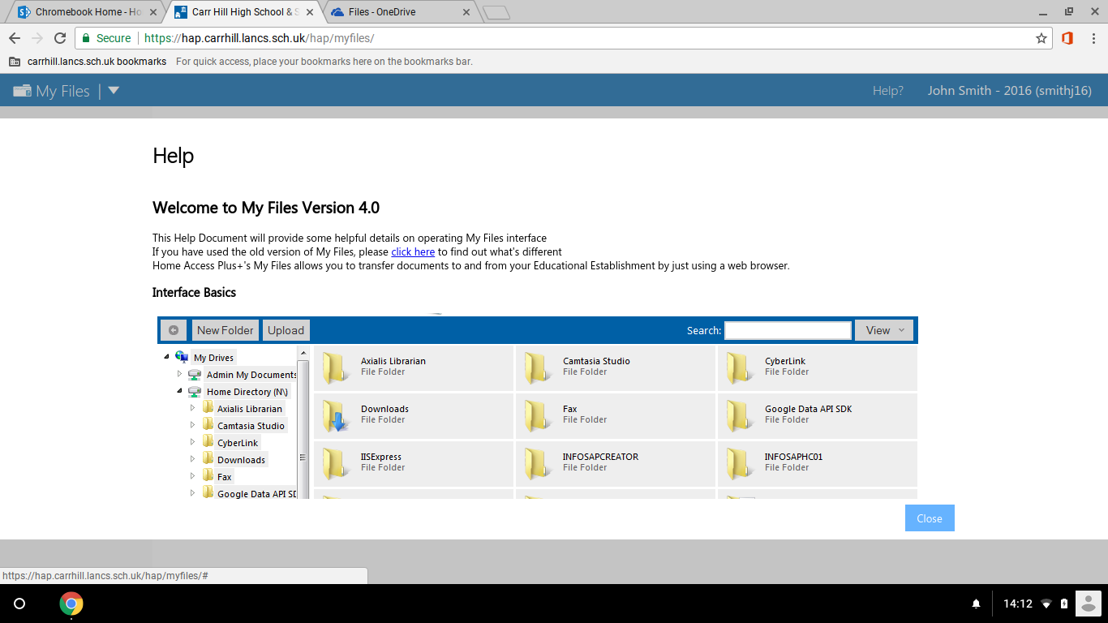
Downloading & Uploading Files
When logging in for the first time you will see the help page below. Click Close in the bottom right corner.

Slide 12
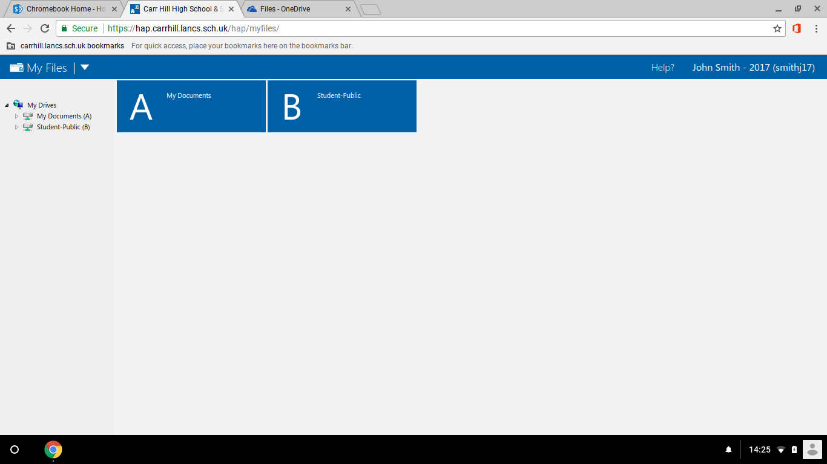
Downloading & Uploading Files
On the My Files page you can access your My Documents area and the Student-public area. Click on Student-Public.

Slide 13
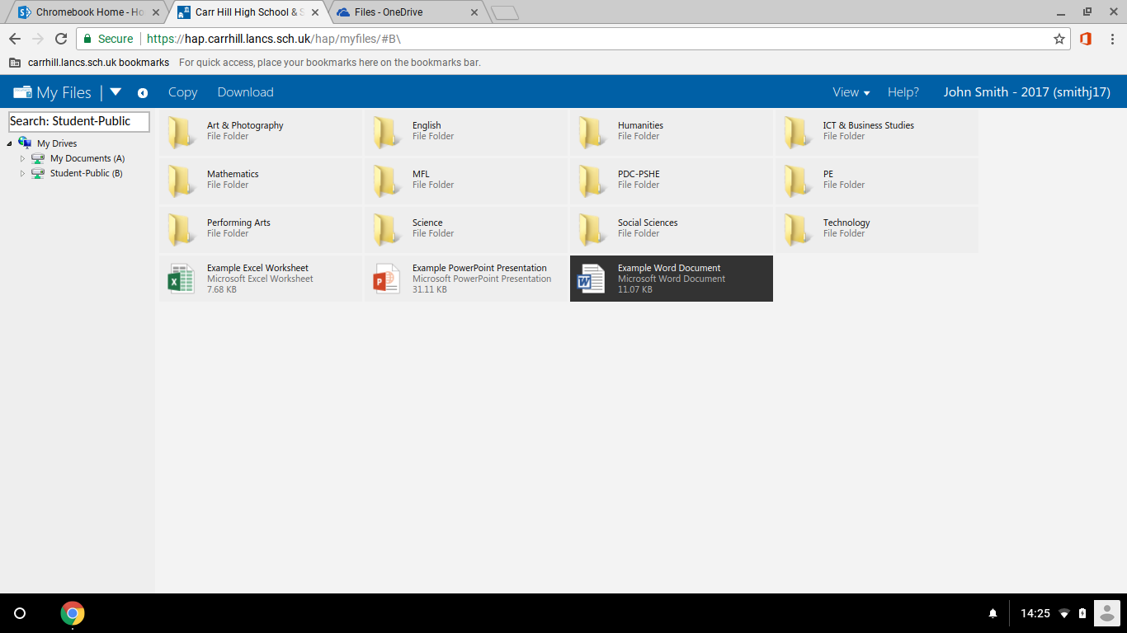
Downloading & Uploading Files
Files saved in the Student-public area can be accessed. There are example Excel, PowerPoint and Word files saved here. Click each of these files and then click Download.

Slide 14
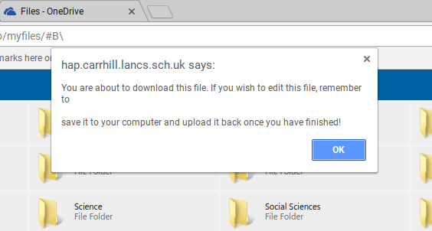
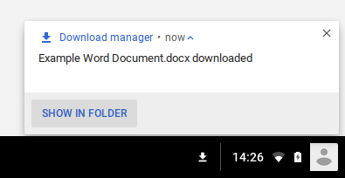
Downloading & Uploading Files
A message will appear like below. Click OK.
When you have downloaded the Excel, PowerPoint and Word files click SHOW IN FOLDER in the bottom right corner.

Slide 15
Downloading & Uploading Files
The Downloads window will open. Select each downloaded file and then click the arrow next to OPEN. Next, click Change default.

Slide 16
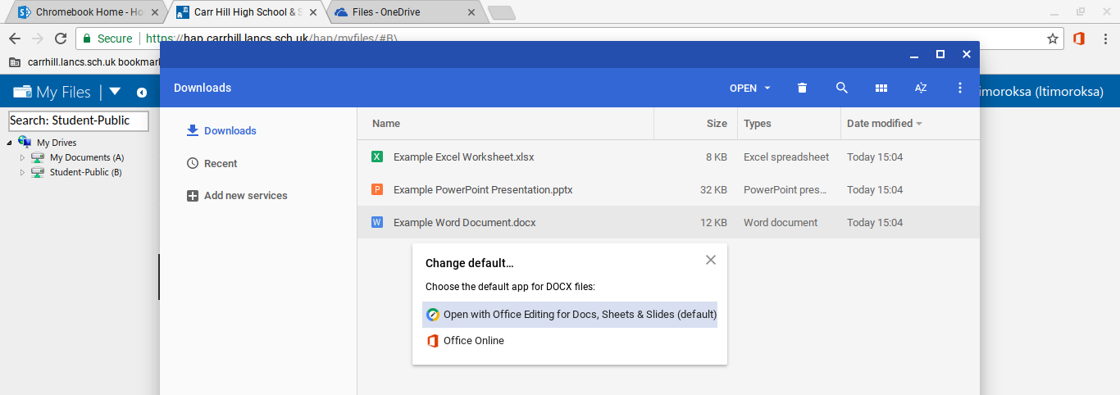
Downloading & Uploading Files
Change the default to Office Online. Repeat this for the Excel and PowerPoint files.

Slide 17
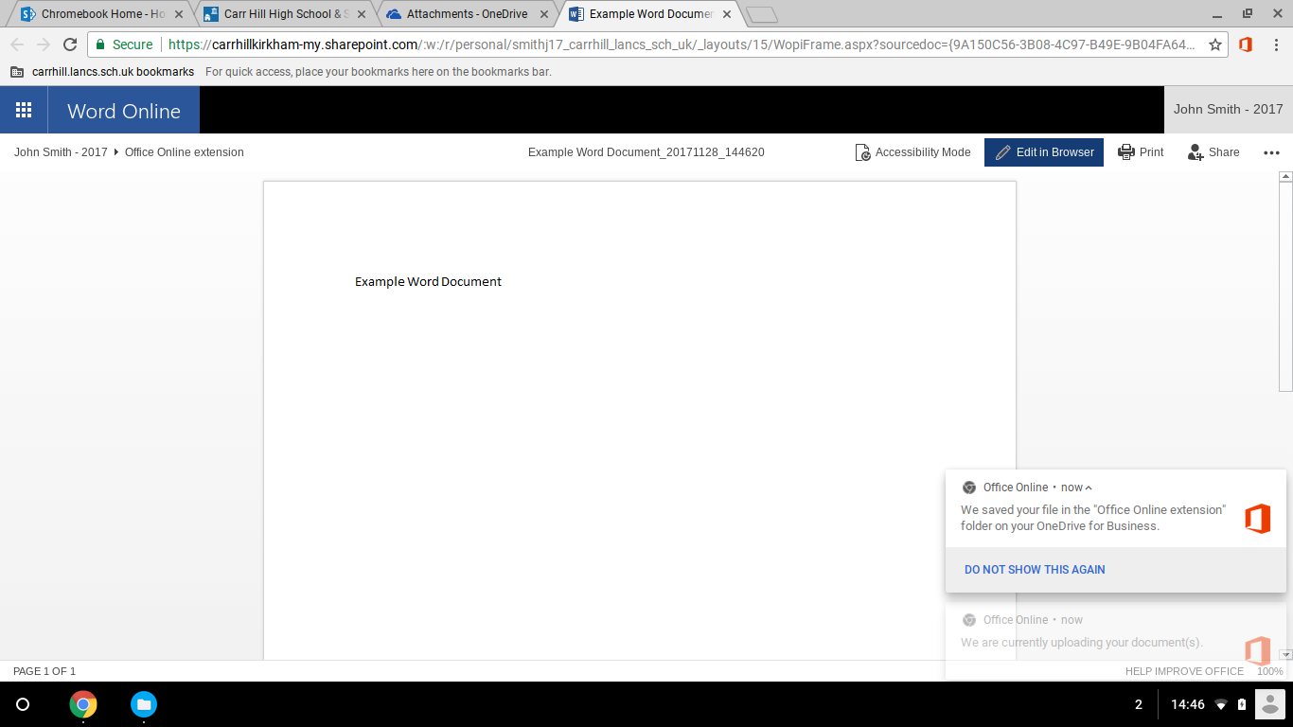
Downloading & Uploading Files
After you have changed the default setting to Office Online, double click the Word file. This will then open up in Word Online like below. To edit the document, you will need to click Edit in Browser.

Slide 18
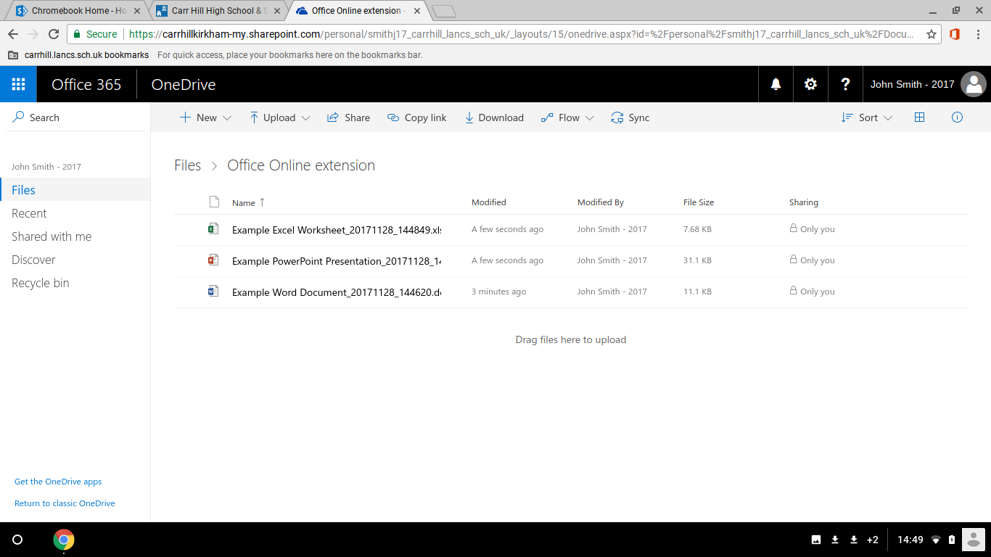
Downloading & Uploading Files
When you are finished editing your document, return to OneDrive and you will see a folder called Office Online extension. In this folder you will see the files that where uploaded earlier. This is where all downloaded files will be uploaded to.

Slide 19
Information
Your Chromebook training is now complete. You can refer to this PowerPoint by going to the Chromebook section on the school website.
There is also a Getting Started with your Chromebook guide on the Chromebook Home page which you can read for more information on your Chromebooks features.
You can now put your Chromebook into the case. To keep your Chromebook from getting damaged, always store it in the case. Do not store the charger in the case as this may damage the screen.

