Slide 1



Thanks for Joining Us
Welcome from the Headteacher and an overview of exam results
Homework and Progress
Initial Testing
Success in English
Success in Mathematics
Success in Science
Behaviour for Learning
Teaching and Learning
Get the latest news, updates and reminders every day.
Carr Hill High School
@CarrHillSchool
All information from this presentation will be available on the website from 1pm tomorrow.

Slide 2
An overview of exam results
Andrew Waller
Headteacher

Slide 3
2018 results highlights
Maths improved by 6% to 68% and was very close to national average of 70%
Science results showed massive improvement and 65% left with 2 sciences which is above national average
17 grade 9s in Biology, Chemistry, Physics
RS improved by 13% and so 54% of students left with an RS GCSE
Art, Computing, Photography, Textiles, Biology, Physics, Chemistry, PE results on or above national average at grade 4+
100% pass rate in Dance, Performing Arts and Sport
Ebacc (Maths, English, Science, MFL, Humanity) up from 9% to 20% at grade 4+
Girls’ pass rate nationally was 71%. We were 70%

Slide 4
2018 areas to work on
We are still not where we need to be in English – so our basics figure won’t change much on 2017
History took a dip in 2018 after good results in 2017 as did Business Studies
Boys need to do better overall but especially in English - so our P8 figure is not likely to change much on 2017! We will be having some specific parent/carer evenings about supporting boys in their learning and you should have received an invite about this (Monday Oct 15th)

Slide 5
The gender gap
 | Carr Hill Maths (NA 71%) | Carr Hill Language (NA 70%) | Carr Hill Literature (NA 73%) | English best
Male | 66% | 47% | 48% | 55%
female | 71% | 66% | 70% | 71%

Slide 6
Year 11 results – vocational courses

Slide 7
Year 11 results – reformed GCSE courses
Name | 9 % | 9 - 8 % | 9 - 7 % | 9 - 6 % | 9 - 5 % | 9 - 4 % | 9 - 3 % | 9 - 2 % | 9 - 1 % | Total Grades
Art | 8.3 | 12.5 | 25 | 29.2 | 45.8 | 79.2 | 95.8 | 100 | 100 | 24
Biology | 6.8 | 16.9 | 32.2 | 61 | 79.6 | 96.6 | 93.5 | 98.4 | 98.4 | 59
Chemistry | 8.5 | 13.5 | 32.2 | 50.8 | 79.6 | 93.2 | 93.5 | 96.8 | 96.8 | 59
Computing | 0 | 4.5 | 13.6 | 22.7 | 36.4 | 63.6 | 86.4 | 90.9 | 95.5 | 22
English Language | 1.6 | 3.2 | 9.7 | 22.6 | 37.6 | 55.4 | 82.8 | 94.1 | 97.3 | 186
English Literature | 1.6 | 4.9 | 12 | 20.2 | 40.4 | 57.9 | 77 | 90.7 | 97.8 | 183
Food & Nutrition | 0 | 7.7 | 15.4 | 23.1 | 23.1 | 23.1 | 69.2 | 84.6 | 100 | 13
French | 0 | 4 | 8 | 26 | 46 | 60 | 80 | 96 | 100 | 50
Geography | 5.3 | 8.8 | 14 | 29.8 | 36.8 | 56.1 | 73.7 | 87.7 | 98.2 | 57
History | 1.9 | 7.5 | 16.8 | 23.4 | 31.8 | 40.2 | 55.1 | 72.9 | 91.6 | 107
Maths | 2.7 | 7.5 | 12.9 | 28.5 | 46.8 | 68.3 | 80.6 | 89.8 | 96.2 | 186
Music | 0 | 0 | 0 | 0 | 33.3 | 66.7 | 100 | 100 | 100 | 3
PE Full Course | 25 | 46.4 | 71.4 | 85.7 | 89.3 | 92.9 | 96.4 | 100 | 100 | 28
Photography | 9.1 | 18.2 | 36.4 | 54.5 | 90.9 | 100 | 100 | 100 | 100 | 11
Physics | 13.6 | 22 | 37.3 | 57.6 | 83.1 | 94.9 | 98.3 | 98.3 | 98.3 | 59
RS Full Course | 1.7 | 5.6 | 14.4 | 25 | 37.8 | 52.8 | 73.3 | 91.7 | 97.8 | 180
Spanish | 8.7 | 13 | 26.1 | 39.1 | 47.8 | 56.5 | 78.3 | 87 | 95.7 | 23
Summary | 3.8 | 8.6 | 17.6 | 30.7 | 46.9 | 63.1 | 79.8 | 91.2 | 97.1 | 1256

Slide 8
Year 11 Results – unreformed courses

Slide 9
High performers top 10
 | Grade 9 | Grade 8 | Grade 7 | total
JW (f) | 8 | 2 |  | 10
JM (f) | 6 | 3 |  | 9
AL (f) | 5 | 2 | 2 | 9
MO (m) | 4 | 4 | 1 | 9
LB (f) | 3 | 2 | 3 | 8
HH (f) | 4 | 1 | 3 | 8
NW (f) | 2 | 3 | 4 | 9
AC (f) | 1 | 4 | 5 | 10
AF (m) | 2 | 3 | 3 | 8
JT (m) | 2 | 3 | 2 | 7

Slide 10


Slide 11

Nomination forms for 2 parent governors will be sent out on Friday October 5th

Slide 12
Progress and Homework
Liz Hilton-Peet
Assistant Headteacher – Head of Key Stage 3

Slide 13
Targets and keeping track of progress
7CSH
Targets are based on KS2 results.
Targets are set using the new GCSE grading 1-9.
Flight paths allow tracking of progress against targets.
Find them in student planners.

Slide 14
Reports
Issued in December, April and July.
Available on Moodle. Paper copies can be requested from the data manager.
We use new GCSE grading 1-9 and a Working Towards grading W1-W3.
We also report our level of confidence in that grade A-C.
We also report an Effort grade.

Slide 15
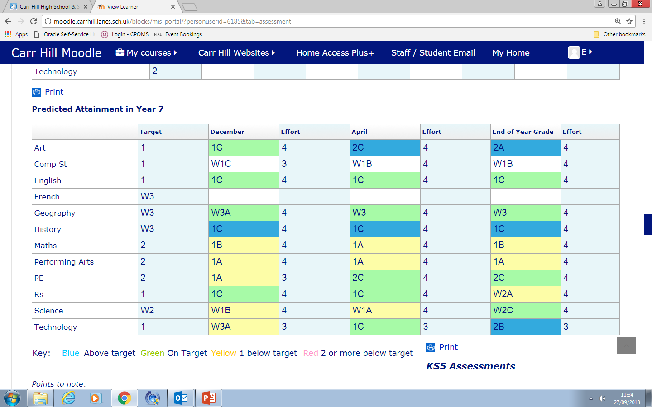

Slide 16
Homework
Encourages good habits of independent learning and private study.
Allow students to prepare for class.
Allows students to demonstrate application of knowledge, understanding and skills.
Encourages parental involvement.

Slide 17
Homework expectations
No homework timetable gives teachers flexibility.
Homework set via Show My Homework, which students and parents have access to.
On average, students in Year 7 receive a minimum of:
60 minutes per week in Mathematics, English and Science.
30 minutes per week in Geography, History and Languages.
30 minutes per fortnight in Art, Computing, Performing Arts, RS and Technology.
We expect homework to be completed to the best of a student’s ability every time.

Slide 18
Homework Club
Every weekday in the library.
Access to computers, printers, books, resources.
Staffed.
Open until 4:30pm Monday-Thursday and 4pm Friday.
The library is also open every weekday morning from 7:45am and at break and lunch.

Slide 19

Show my Homework
All students have received basic
Show My Homework training in computing lessons.
Notes:
Help clubs – Friday lunch room 26
Apps for phones – not always available
Emailed presentation.
Presentation on school website
Majority of problems – wrong password or email

Slide 20
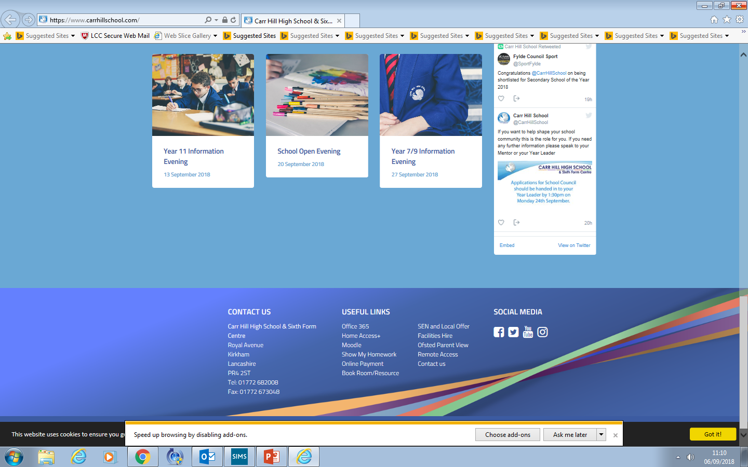
Using Chrome access the Carr Hill Website and at the bottom under “Useful Links” click “Show my Homework”

Slide 21
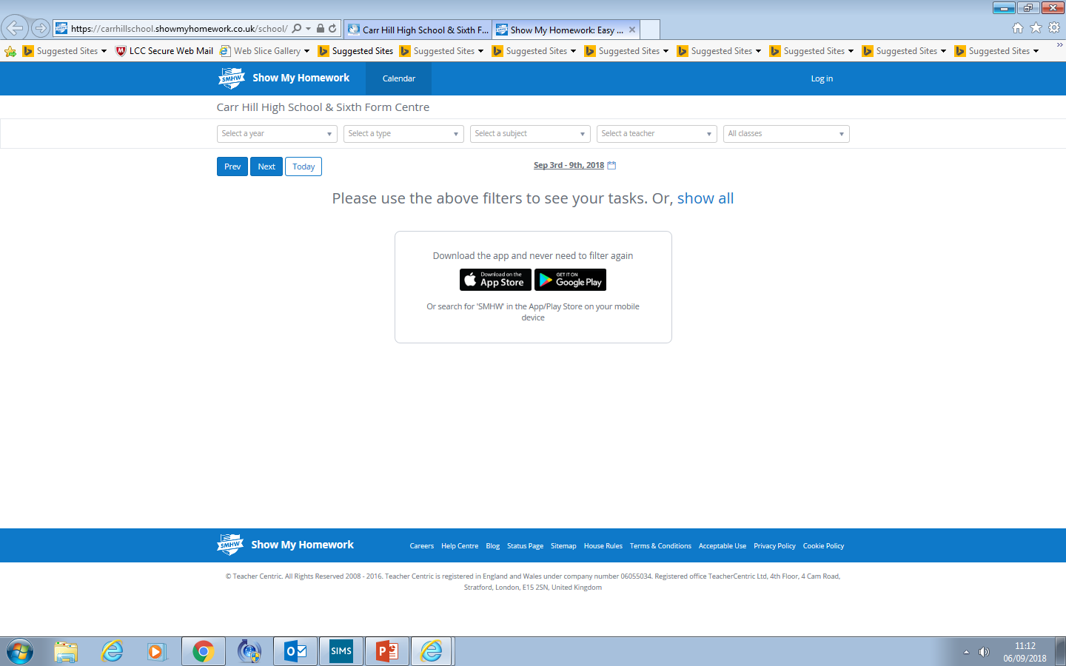
Log in

Slide 22
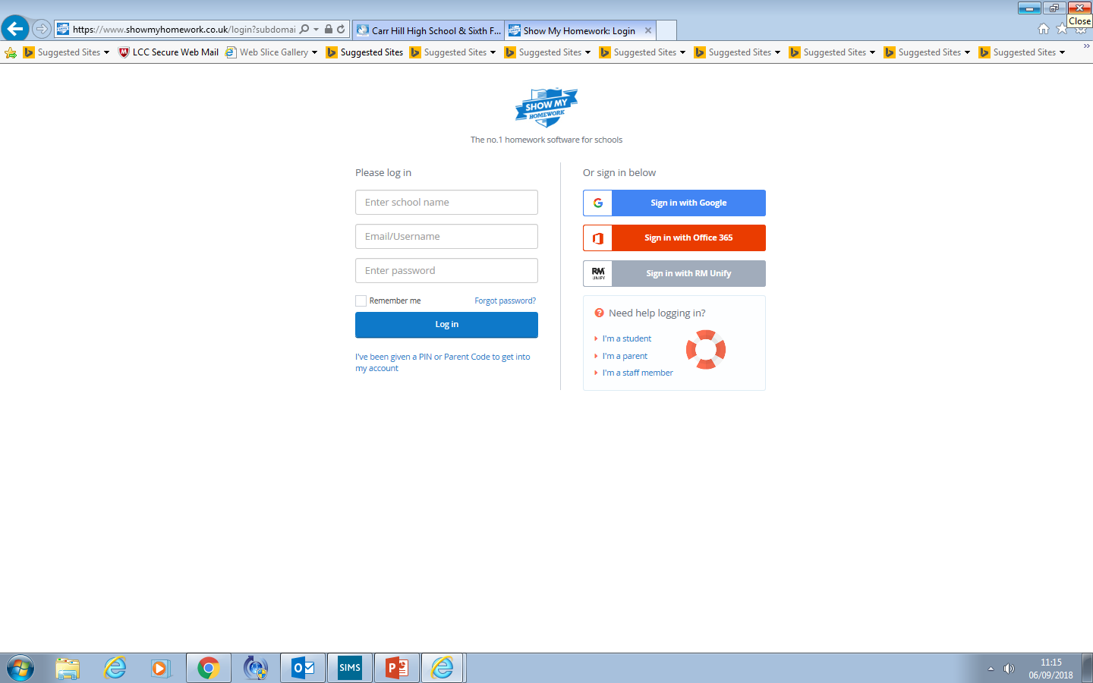
Click here - Use the Red Office 365 button to log in

Slide 23
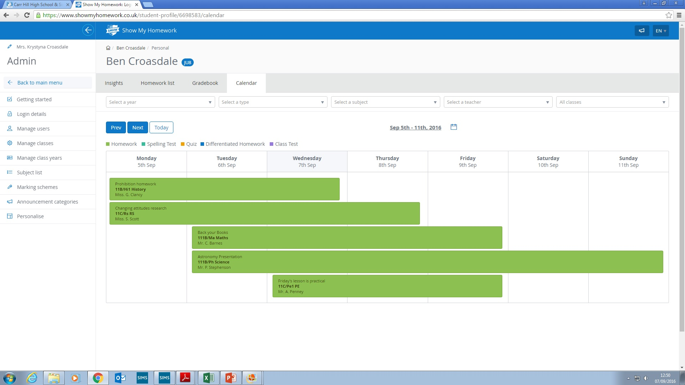
They now have access to their account on Show My Homework

Slide 24
Initial testing
Joanne Darkin
SENCo
Notes:
Help clubs – Friday lunch room 26
Apps for phones – not always available
Emailed presentation.
Presentation on school website
Majority of problems – wrong password or email

Slide 25
LASS and Exact
As a school we use LASS to identify dyslexic tendencies as well as other learning needs.
LASS allows us to identify poor visual, auditory and verbal memory as well as single word reading, spelling and reasoning.
Exact is a time efficient assessment that highlights learning barriers in more detail.
Exact is also a time efficient assessment that allows us to identify which students may qualify for an access arrangement.
Identified learning barriers are followed up on and supported using an appropriate intervention where impact can be measured.
Differentiation through Quality First Teaching, IDL, LEXIA and SLCN support are some of the interventions we use to support students with identified barriers to learning.
We cannot test and give a diagnosis for dyslexia.
What we can do is ensure students, parents and staff, have access to strategies that will support a students unmet needs. Strategies that provide the opportunity, for every student to achieve their full potential.

Slide 26
Boxall-Testing
Boxall was developed in 1969 by a leading psychologist, it has continued to be developed and used effectively to date.
Boxall provides a framework for the precise assessment of students who experience social and emotional difficulties.
Boxall measures progress through different aspects of development in the pre-school years. Satisfactory completion of early years development is crucial, if students are to make good use of their education opportunities.
Boxall is not a test that can be used to diagnose a student with a condition.
It is a test that provides information allowing us to support any unmet needs. As a result, we develop interventions, programmes and strategies that are effective and sustainable. Strategies that support students self worth, resilience and wellbeing etc.
Boxall is one of the most effective ways to monitor the core of the whole student.
Research provides both formative and summative evidence, demonstrating the impact gained from using Boxall.
Unlike LASS and Exact that are used in relation to cognitive ability, not every child will need a Boxall assessment.

Slide 27

English
Kathryn Gardner
Assistant Head of Faculty

Slide 28
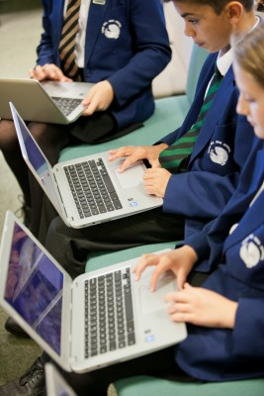
Interventions include one to one or work within small groups. These will usually be within their normal English lessons and they include both in-class support and withdrawal from lessons on a short term basis. The latter is usually done within timetabled library lessons.
If other arrangements for more sustained intervention are needed, you will always be informed and regularly updated.

Slide 29
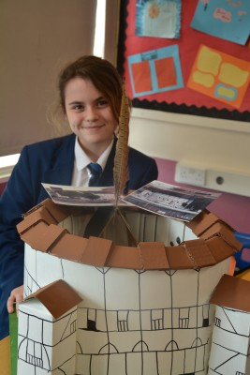
The Year 7 Course
The year 7 English course consolidates and develops skills taught at KS2 whilst preparing students for forthcoming GCSE English and Literature study.
Students will read a range of fiction and non-fiction texts including Shakespeare and other pre twentieth century texts. They learn to develop the skills of analysis. A variety of writing styles are practised and there is a focus on improving technical accuracy – spelling, punctuation and grammar.
In addition to this curricular work, the English department offers a range of extra-curricular activities and competitions to encourage students to write for different audiences and to promote a love of literature and reading.

Slide 30


Reading Challenge
In English, we have created the Carr Hill Reading Challenge! Students are challenged to read a range of fiction and non-fiction texts. Then, they record and review their ideas about these texts in their booklets.
As students read more widely, they receive certificates to celebrate their successes.

Slide 31
Parents and Carers
You can help to support your child by encouraging them to read widely and regularly.
Regular reading impacts on comprehension skills and writing skills as well as helping your child to become an independent learner.
Thank you for encouraging your child to complete such tasks regularly as on-going homework.

Slide 32

Mathematics
James Myers
Assistant Head of Faculty

Slide 33
Mathematics in Year 7
Algebra, number, ratio, geometry and statistics building on the work in year 6.
Learn the skills to enable problem solving.
Each fortnight, one lesson will be used for students to spend time preparing a revision sheet before completing a knowledge check.
Differentiated target classwork and homework will be given to students from these results.
If a student still appears to have gaps in knowledge they will be asked to attend intervention at lunch or after school to catch them up immediately.
The revision sheets will be returned to students each year before the relevant topic for revision.

Slide 34
How can parents/carers help?
Be positive
Encourage your child to be positive
Encourage your child to be resilient
Encourage your child to ask for help
Ensure your child has the correct equipment for lessons

Slide 35
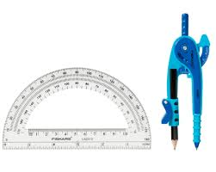
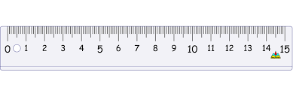
Reminders
Your Maths book should be backed.
On your desks should be:
Your pens: Blue/Black, Red and Purple.
Maths Book (backed). Planner. Calculator.
Geometry Equipment: Ruler, Compass and Protractor.
At the start of each lesson:
Rule off from the previous lesson.
Always write ‘cwk’ and the date and underline both.

Slide 36
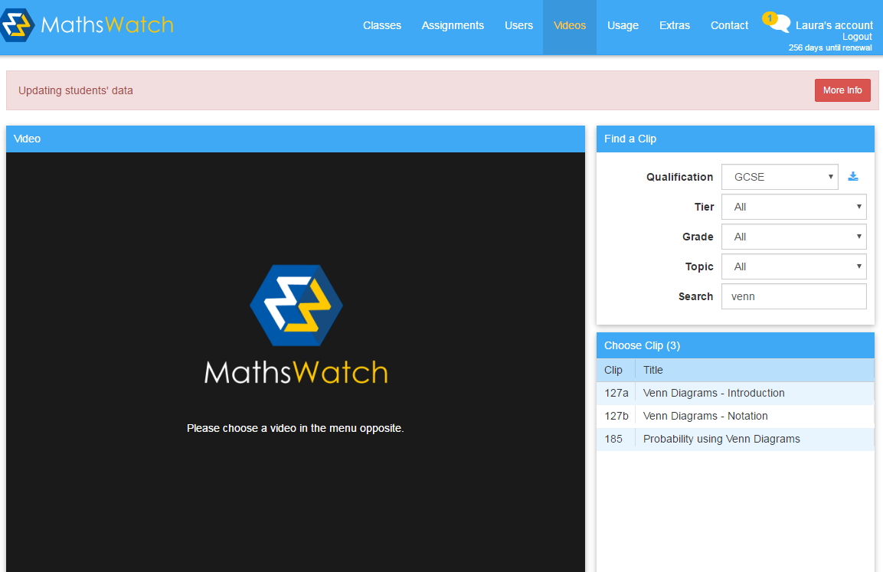
What is Mathswatch?
Notes:
Once we have covered the entire specification we then concentrate on using the assessments to identify each students areas of weakness.
After each assessment the teacher will receive a class report and each individual will receive an individual feedback sheet.
The teacher will initially address any misconceptions and areas of weakness shared by the class and then go onto deal with any individual issues using appropriate resources ( i.e. laptops and computer rooms).
It is essential students take responsibility at this point and take the opportunity to address issues independently maximise their final grade.

Slide 37
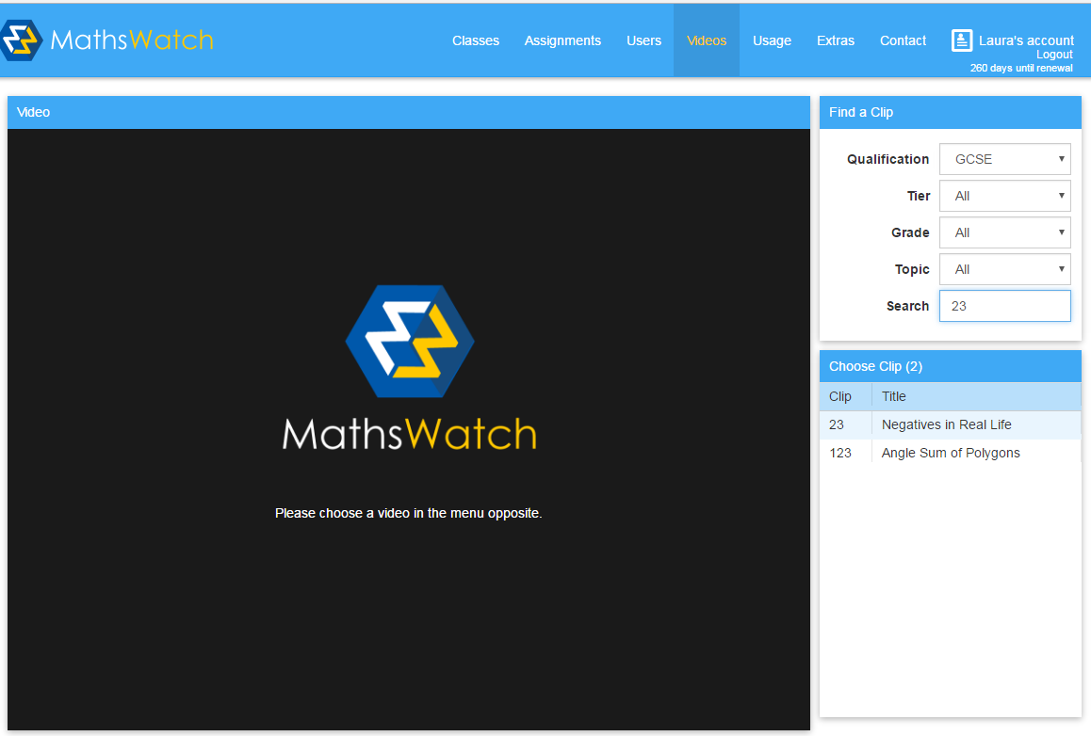
Mathswatch
For all students, you need to log on to vle.mathswatch.com
Login details for Isaac Newton would be:
User name: inewton@carrhill
The password is numbers
To watch a video:
Click video
Select GCSE
Search for the clip number
Select the one you want to watch

Slide 38
What support is available?
Their classroom teacher (at the appropriate time).
Tuesday and Thursday lunchtime room 4.
The Maths office.
Their mentor.
Web based resources.
Notes:
Intervention has already begun and will be changing throughout the year depending on assessment results. When students are timetabled for extra intervention you will be informed.
The intervention days are run throughout the year and have proved to be quite successful.

Slide 39

Extra-Curricular Activities
Maths Club (Wednesday Lunch Time)

Slide 40




Revision Guides

Slide 41

Science
Cathy North
Head of Science

Slide 42
Year 7 Structure: the 10 Big Ideas

Slide 43
Year 7 students:
Set according to their Maths and English KS2 grades because Science needs both of these skills.
Take long assessments and AWL’s in topics to enable them to revise more content each time and develop revision techniques.
Will also undertake an examination towards the end of the year.
Will develop Scientific skills and learn how to think in a Scientific way- Independent research, Investigation, “trial and error”.
Will learn from their mistakes and develop resilience.
Notes:
The first 3 just enable the smooth running of a classroom allowing the teachers to concentrate on the curriculum as much as possible.
The final point I will refer to several times throughout the presentation.
“The one person who has the greatest impact on a students results are the student themselves.

Slide 44
In Science lessons students will:
Do practical work where possible.
Extend and develop Maths skills so will need a calculator.
Meet new words that they will have to remember the meanings of that are Science specific and use the 13 words from the Academic Word List that they need to understand for all subjects.
Explore the 10 Big ideas about Science through investigation and research.
Experience the kind of questions found in AQA GCSE’s.
Notes:
The first 3 just enable the smooth running of a classroom allowing the teachers to concentrate on the curriculum as much as possible.
The final point I will refer to several times throughout the presentation.
“The one person who has the greatest impact on a students results are the student themselves.

Slide 45
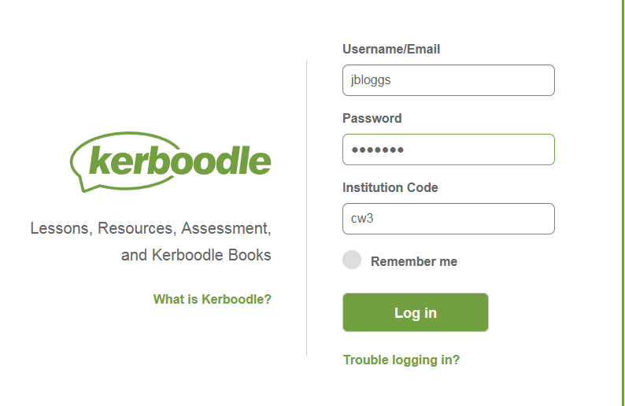
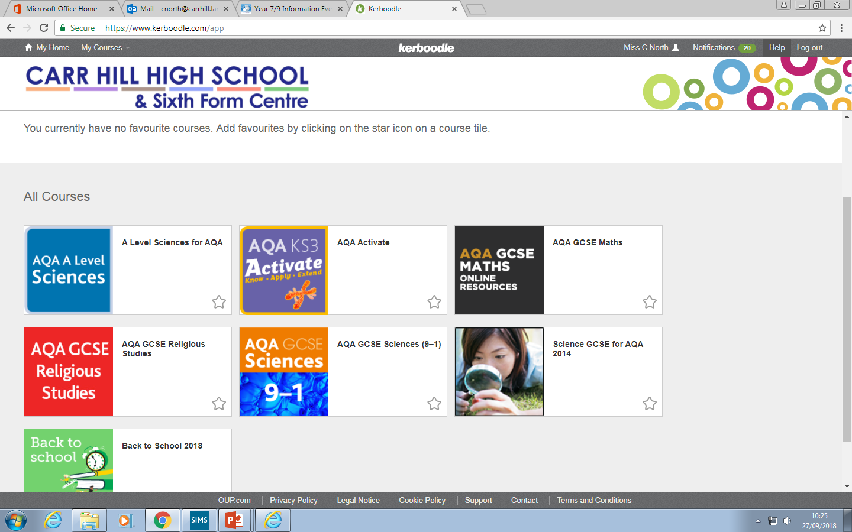

Slide 46
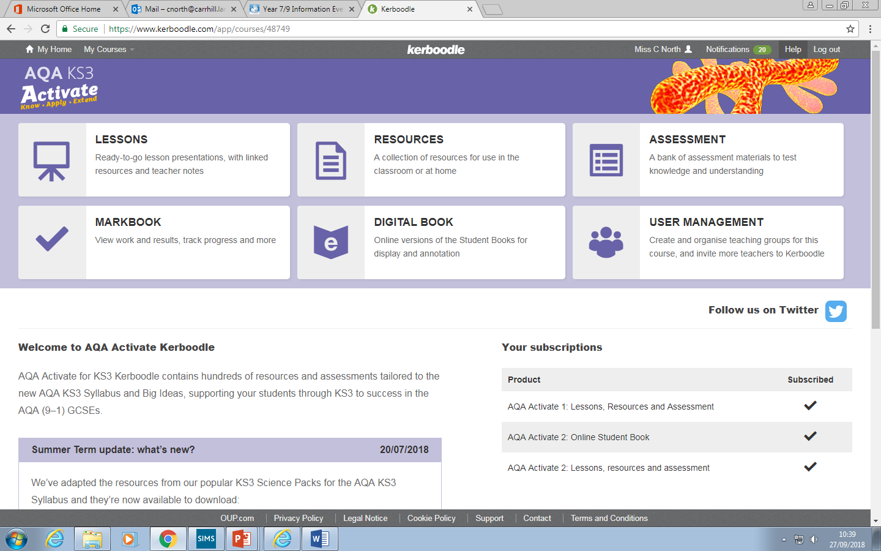
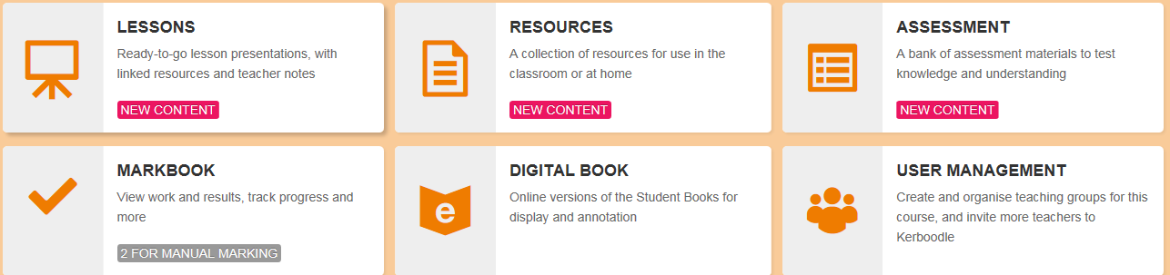
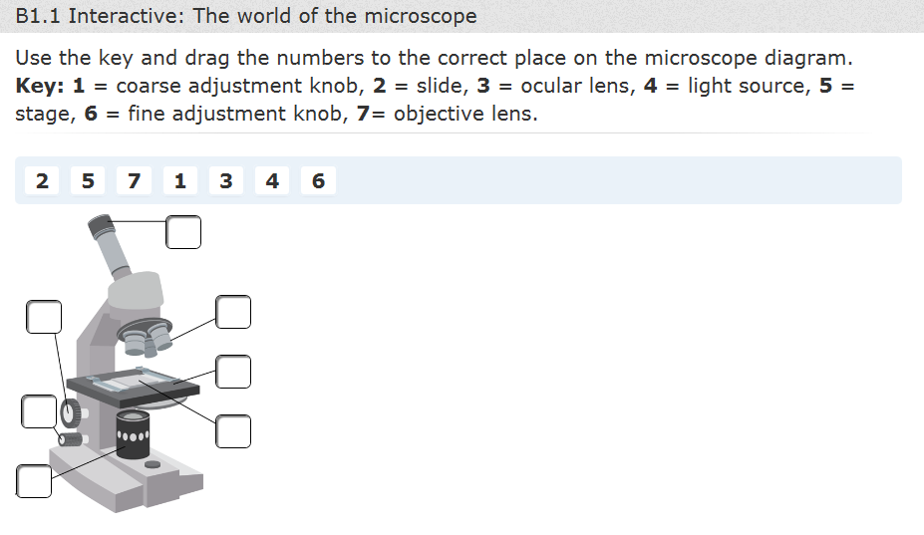
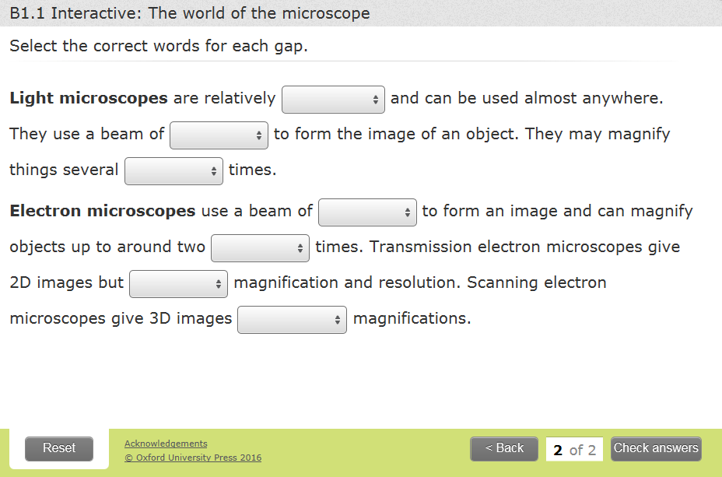

Slide 47
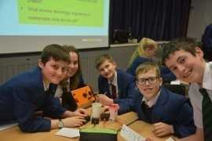
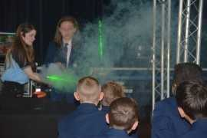
Enrichment Activities
Faraday Challenge
STEM clubs

Slide 48
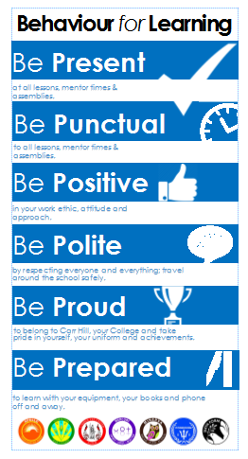
Behaviour For Learning
Adam Penney
Head of Year 7

Slide 49
Expectations:

Slide 50
Reward Systems:
  Merits - these are issued on a daily basis to recognise achievement across the school and are recorded on SIMs.
  On a half termly basis student merits will be counted and recognised through Year Group Celebration Assemblies.
  Faculty rewards – positive text messages, praise post cards, telephone calls, verbal praise.
  6 ‘P’ Card, which reflects our code of conduct and recognises achievement and behaviour out of the classroom.
  End of year Celebration Events

Slide 51
6 – P Card:
6 P Card – Achievement and conduct out of the class
Each student begins each half term with 10 merits recorded on their ‘P Card’. At the end of a half term these merits will be transferred a students behaviour record and will count towards yearly totals.
These Merits will be entered into a prize draw each half-term, 1 merit = 1 entry.
There will be 2 draws– one for those who have maintained 10 merits and one for those with 6-9 merits
Opportunities will be given to students to earn additional merits
Each half term certificates will be awarded to students based on the number of merits earned on their P Card.
Merits can be earned by getting involved in activities, and by enhancing the life of the school.
Merits be can lost for failing to adhere to our code of conduct outside of the classroom.
There is an expectation that all students will have their card on their person at all times. Failure will result in Detention.

Slide 52
Starting Lessons off positively:
In classrooms students must:
Enter quietly when instructed to do so
Stand in silence behind chairs
Wait for the teachers instructions
When asked, ensure that they have out all their equipment

Slide 53
Consequences of not following instructions:
Lesson Time:
Stage 1 - Formal Warning
Stage 2 – Demerit & Move
Stage 3 – Time Out
Break/Lunch:
Detentions by Faculty or pastoral staff
After school
Pastoral Head detentions (Thursday till 3.50pm)
Serious Defiance detentions (Tuesday – Friday till 4.10pm)
Headteacher’s Detention (Friday till 4.30pm)
Exclusion
Internal exclusion from 8.55am till 4pm
Fixed term exclusion out of school

Slide 54
We want to all students to have access to a happy and safe learning environment where they can thrive to achieve great success in the future.

Slide 55
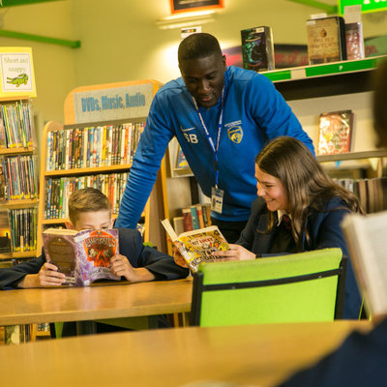
Learning at Carr Hill
Danny Morton
Assistant Head for Teaching & Learning

Slide 56
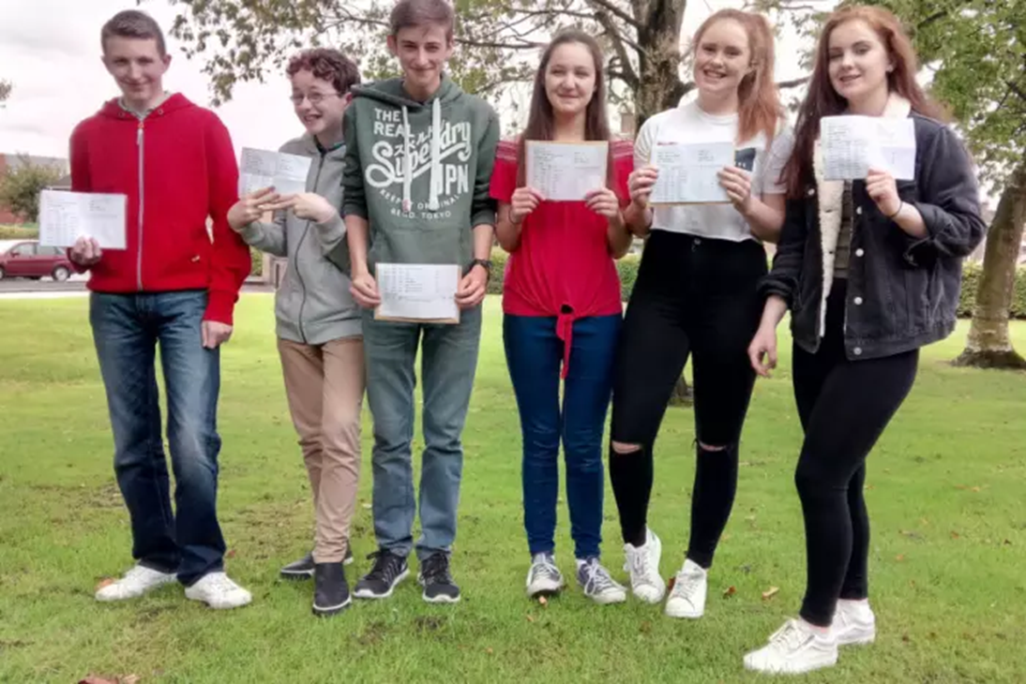
Our Focus Your Aim
Engagement
Challenge
Literacy
Assessment & Feedback
Progression
Notes:
Whilst as our T and L focus has evolved from this I think this is still good for parents to hear as our aim for their children.

Slide 57

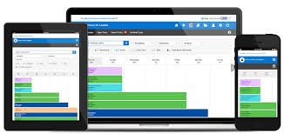
Homework
Notes:
The importance of completing homework from a T and L point of view, educational research shows that pupils who do homework (real effort not the bare minimum) make more progress than those who don’t do it or put in the bare minimum effort.

Slide 58



Feedback
Notes:
Green pen is subject content feedback. Pink highlight is a literacy mistake to be corrected both are to be completed in RAP (reflect and progress) time using a purple pen. This is an opportunity for pupils to learn from their mistakes and consolidate their progress. As with homework educational research shows that pupils who do act on their feedback make more progress than those who don’t do it.

Slide 59
“It is important for us to embrace the use of technology to maintain an innovative approach to teaching and learning which fully prepares students for further education and employment in a technological world”

Slide 60
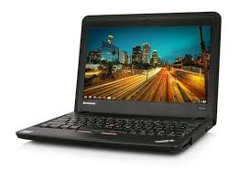
Previously we have run a Chromebook scheme enabling students to have their own Chromebook.
Laptop-style device
Google operating system
Secure, safe & simple to use
Long life-span
Light in weight
Robust

Slide 61

We also included the option for students to bring their own laptop style device

Slide 62
Technology Trial
This year we are trialling a range of tablets in school in order to assess the possibility of offering both a laptop style device and a tablet as well as facilitating students bringing their own appropriate device.

Slide 63

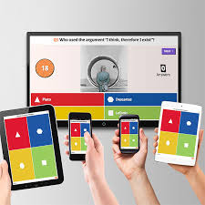





How do we use technology in school?

Slide 64
Thank you for coming
Don’t forget that this presentation will be available on the school website from 1pm tomorrow.

