Slide 1



Thanks for Joining Us
Setting and options
Show my Homework
GCSE reform, targets and making progress
Success in English
Success in mathematics
Success in science
Behaviour for Learning
Teaching and Learning including Chromebooks
Get the latest news, updates and reminders every day.
Carr Hill High School
@CarrHillSchool

Slide 2
Setting and Options
Liz Hilton-Peet
Assistant Headteacher

Slide 3
Setting
C | H | S
C1 | H1 | S1
C2 | H2 | S2
C3 | H3 | S3

Slide 4
Options
Subject assemblies this term
Careers day – Monday 23rd October
Options evening – 1st February
Year 8 parents evening – 8th February

Slide 5
Options process
Individual booklet with details of the process
Explanation of the different types of courses – BTEC vs. GCSE
Likely targets in each subject
Information on all the subjects

Slide 6
Show my Homework
Liz Hilton-Peet
Assistant Headteacher
Notes:
Help clubs – Friday lunch room 26
Apps for phones – not always available
Emailed presentation.
Presentation on school website
Majority of problems – wrong password or email

Slide 7
Before a student can access
Show My Homework they need to have logged into their school email

Slide 8
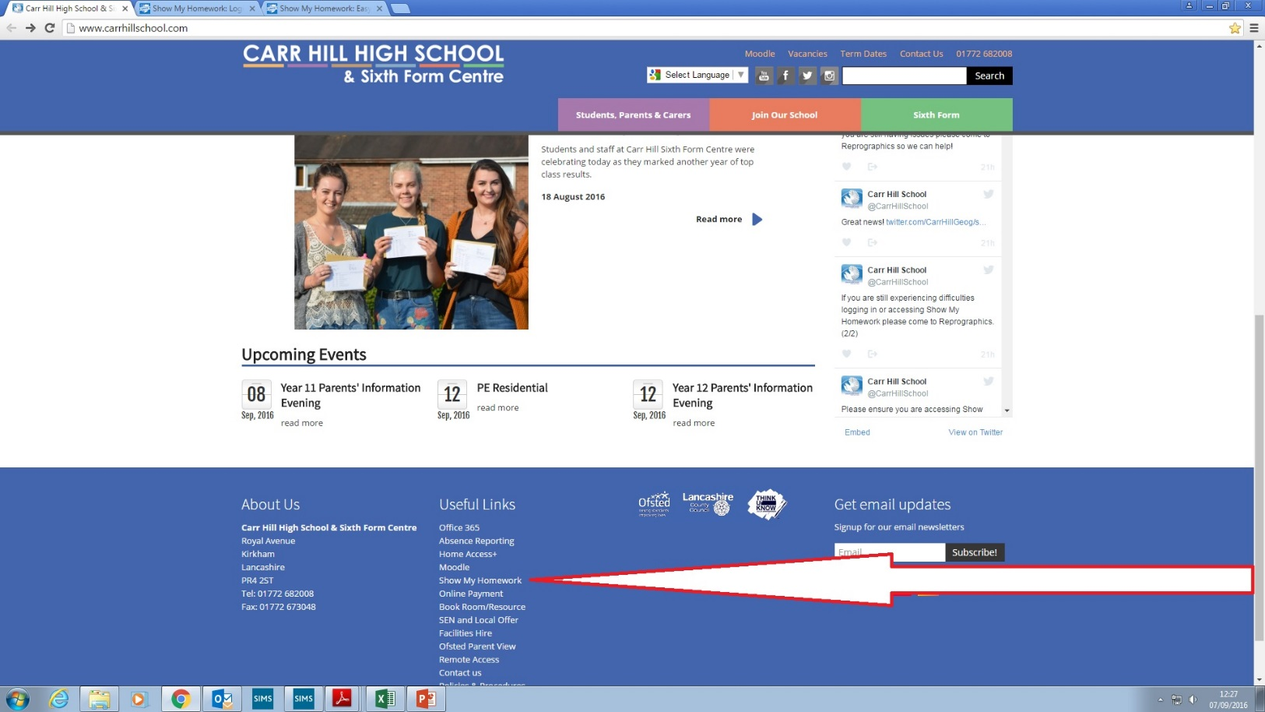
Show my Homework
Using Chrome access the Carr Hill Website and at the bottom under “Useful Links” click “Show my Homework”
Click here

Slide 9
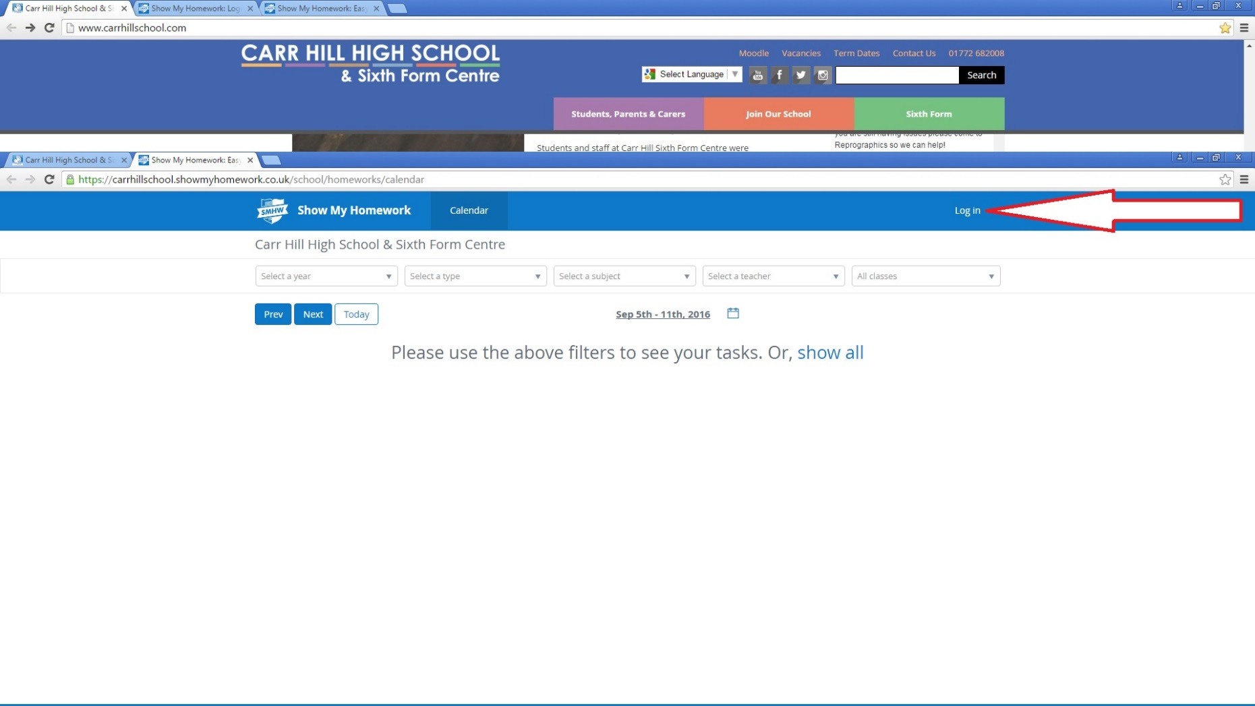
Log in
Click here

Slide 10
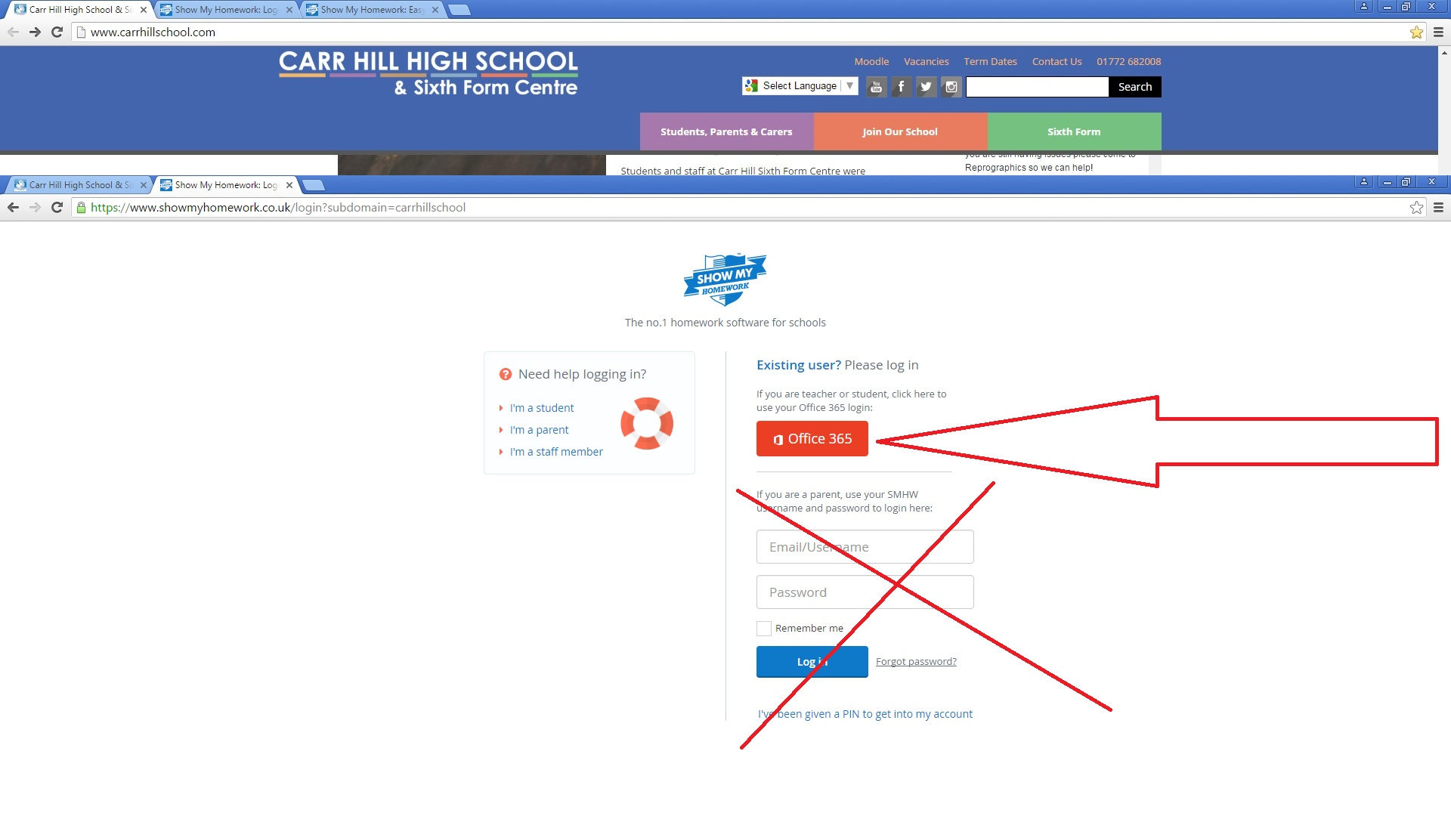
Click here - Use the Red Office 365 button to log in
DO NOT USE THIS SECTION TO LOGIN USE THE ABOVE RED OFFICE 365 BUTTON

Slide 11
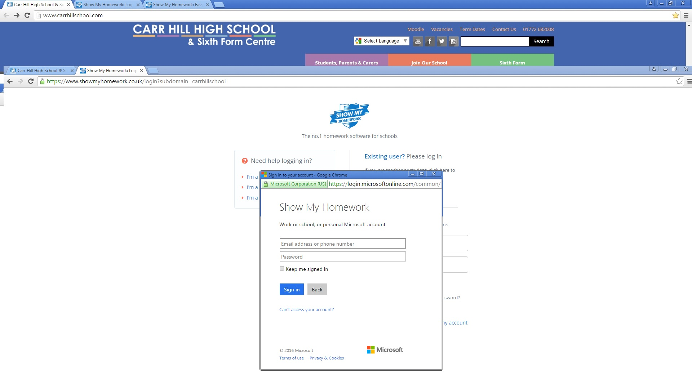
Log in with their full school email address and password

Slide 12
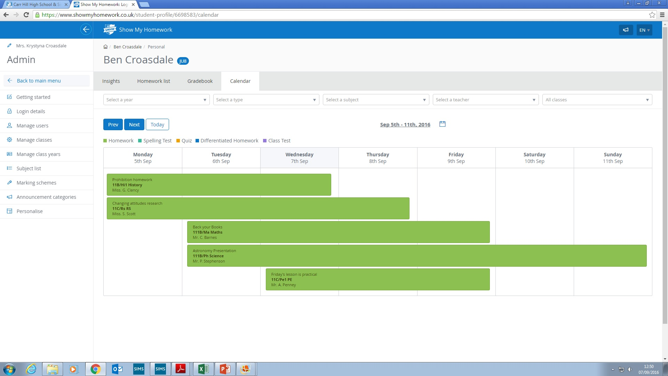
They now have access to their account on Show My Homework

Slide 13
GCSE reform, targets and monitoring progress
Liz Hilton-Peet
Assistant Headteacher

Slide 14
Why and how are GCSEs changing?
GCSEs and A levels in England are being reformed, to match the best systems in the world and keep pace with universities’ and employers’ demands.
GCSE content will be more challenging and rigorous but still suitable for all abilities.
GCSEs will be graded on a new scale of 9 to 1 rather than A* to G, with 9 the highest grade, to distinguish clearly between the reformed and unreformed qualifications.
Assessment is mostly by examination rather than partly by coursework.
Foundation and higher tiers are now only available in maths, science and languages.
Grading is now on a 1-9 scale rather than on an A*-G scale.

Slide 15
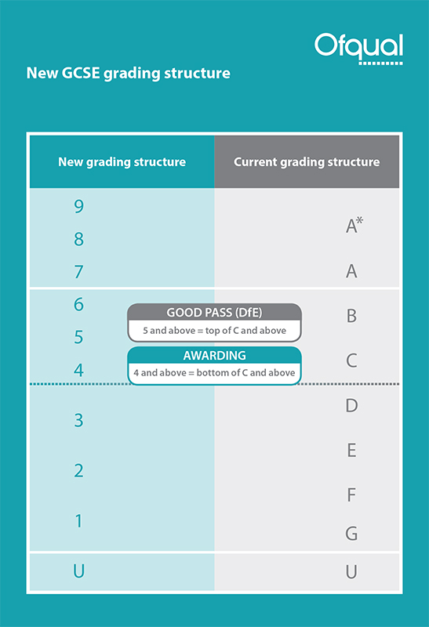
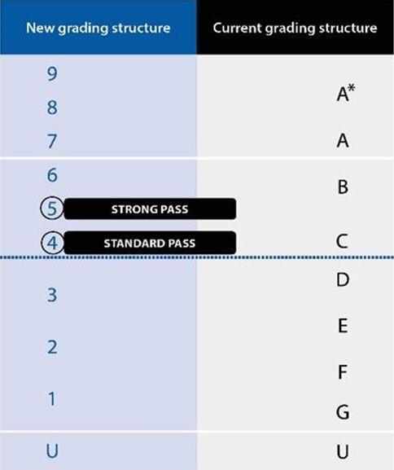

Slide 16
Setting Targets
Above Average School - Physics
KS2 | KS3 |  |  | KS4
Average Scaled Score (Reading / Maths) | Year 7 Target | Year 8 Target | Year 9 Target | Year 10 Target | Year 11 Target
112-120 |  |  |  |  | 8
110-111 |  |  |  |  | 8
107-109 |  |  |  |  | 7
103-106 |  |  |  |  | 6
99-102 |  |  |  |  | 5
93-98 |  |  |  |  | 4
89-92 |  |  |  |  | 3
80-88 |  |  |  |  | 2
Below Level Test |  |  |  |  | 2

Slide 17
Keeping track of progress
Flight paths.
Allows tracking of progress against targets.
Find them in student planners.

Slide 19
Reports
1-9 grade and A-C confidence level reported in all subjects. For example 2A.
A – very confident of grade
B – confident of grade
C – not as confident of grade
Available on Moodle. Paper copies can be requested from the data manager
October, December, April and July
A subject in the “red” is a cause for concern

Slide 20

English

Slide 21
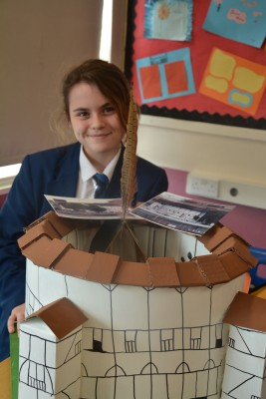
The Year 8 Course
The year 8 English course consolidates and develops skills taught at KS2 whilst preparing students for forthcoming GCSE English and Literature study.
Students will read a range of fiction and non-fiction texts including contemporary drama and pre twentieth century texts. They learn to develop the skills of analysis. A variety of writing styles are practised and there is a focus on improving technical accuracy – spelling, punctuation and grammar.
In addition to this curricular work, the English department offers a range of extra-curricular activities and competitions to encourage students to write for different audiences and to promote a love of literature and reading.

Slide 22


Reading Challenge
In English, we have created the Carr Hill Reading Challenge! Students are challenged to read a range of fiction and non-fiction texts. Then, they record and review their ideas about these texts in their booklets.
As students read more widely, they receive certificates to celebrate their successes.

Slide 23
The Library
All Y8s now have one library lesson per fortnight. These take place in one of their English lessons.
Children are accompanied by their class teacher and our intervention mentor. This means they can have targeted support for literacy intervention and a chance to do one to one reading.
The librarian will also work with small groups of pupils – this could be on Reading Challenge work or improving research skills.

Slide 24
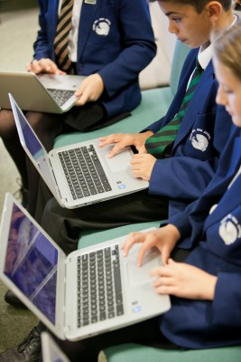
Interventions include one to one or work within small groups. These will usually be within their normal English lessons and they include both in-class support and withdrawal from lessons on a short term basis. The latter is usually done within timetabled library lessons.
If other arrangements for more sustained intervention are needed, you will always be informed and regularly updated.

Slide 25
Assessments
Your child will complete a range of assessments covering a variety of skills and techniques. These are transferrable skills across language and literature. Assessments are completed in a separate book – not their class work book.
Last year, we introduced AQA exams as our end of year assessments at KS3. This ensures a smoother transition from one key stage to the next. The progression through grades also becomes easier to track.
This year we have ensured that all our assessments use the same question stems as AQA GCSE

Slide 26
Parents and Carers
You can help to support your child by encouraging them to read widely and regularly.
Regular reading impacts on comprehension skills and writing skills as well as helping your child to become an independent learner.
Thank you for encouraging your child to complete such tasks regularly as on-going homework.

Slide 27

Mathematics
Laura Potts
Assistant Head of Faculty

Slide 28
What we expect from the students?
Bring all the necessary equipment.
Excellent attendance and punctuality.
Excellent behaviour.
Greater independence and responsibility.
Notes:
The first 3 just enable the smooth running of a classroom allowing the teachers to concentrate on the curriculum as much as possible.
The final point I will refer to several times throughout the presentation.
“The one person who has the greatest impact on a students results are the student themselves.

Slide 29
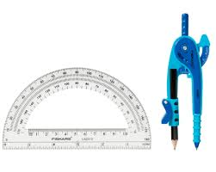
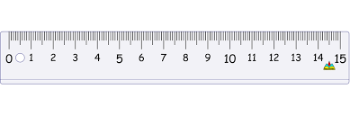
Reminders
Your Maths book should be backed.
On your desks should be:
Your pens: Blue/Black, Red and Purple.
Maths Book (backed). Planner. Calculator.
Geometry Equipment: Ruler, Compass and Protractor.
At the start of each lesson:
Rule off from the previous lesson.
Always write ‘cwk’ and the date and underline both.

Slide 30
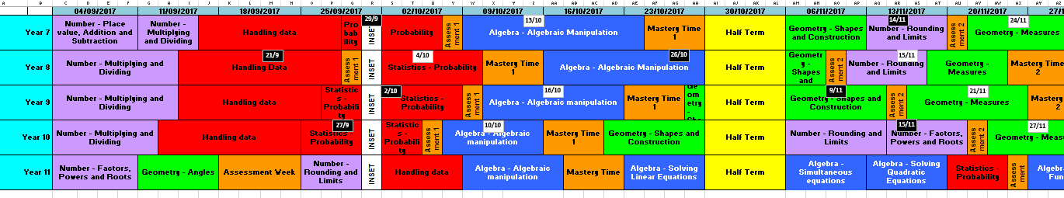
What will they be learning?
Notes:
The first 3 just enable the smooth running of a classroom allowing the teachers to concentrate on the curriculum as much as possible.
The final point I will refer to several times throughout the presentation.
“The one person who has the greatest impact on a students results are the student themselves.

Slide 31
What will this year look like?
Notes:
All staff work from this timeline.
Each row is a half term.
First coloured sections are different topics within the subject.
Each section has a detailed sow associated with it.

Slide 32
How to prepare for an Assessment.
Students will be set a revision homework.
Their class teacher will go through this before their assessment.
They will be able to take their books in to their assessments.

Slide 33
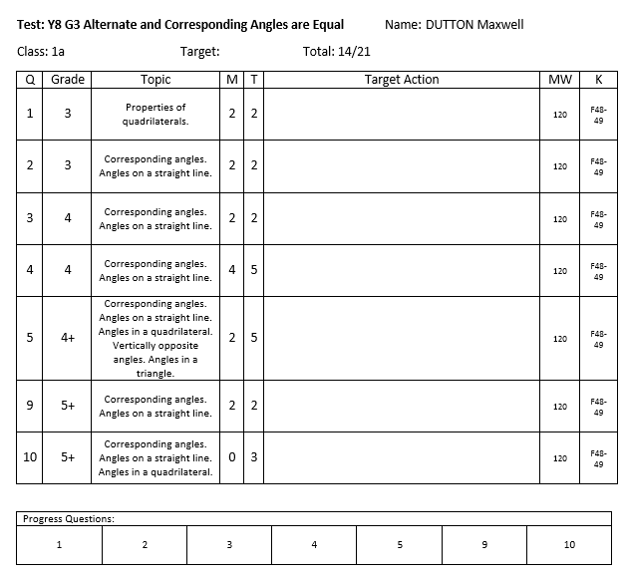
What is mastery time?
Notes:
Once we have covered the entire specification we then concentrate on using the assessments to identify each students areas of weakness.
After each assessment the teacher will receive a class report and each individual will receive an individual feedback sheet.
The teacher will initially address any misconceptions and areas of weakness shared by the class and then go onto deal with any individual issues using appropriate resources ( i.e. laptops and computer rooms).
It is essential students take responsibility at this point and take the opportunity to address issues independently maximise their final grade.

Slide 34
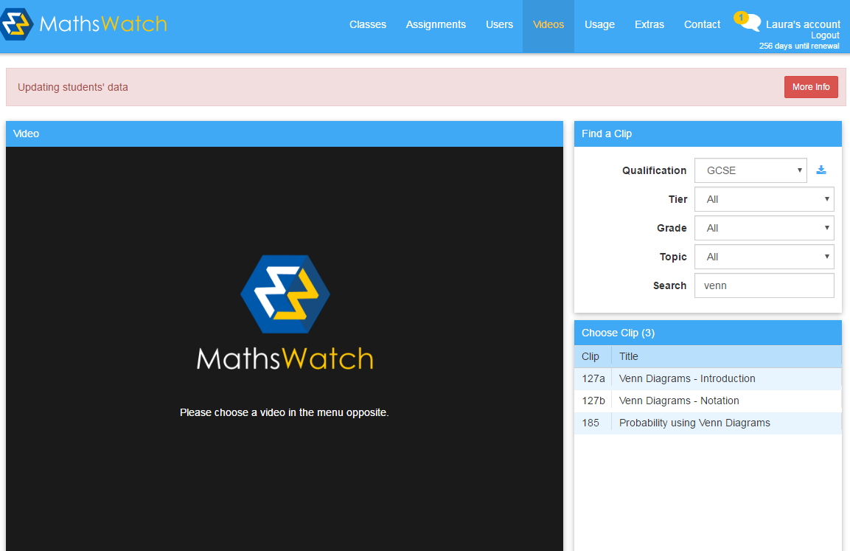
What is Mathswatch?
Notes:
Once we have covered the entire specification we then concentrate on using the assessments to identify each students areas of weakness.
After each assessment the teacher will receive a class report and each individual will receive an individual feedback sheet.
The teacher will initially address any misconceptions and areas of weakness shared by the class and then go onto deal with any individual issues using appropriate resources ( i.e. laptops and computer rooms).
It is essential students take responsibility at this point and take the opportunity to address issues independently maximise their final grade.

Slide 35
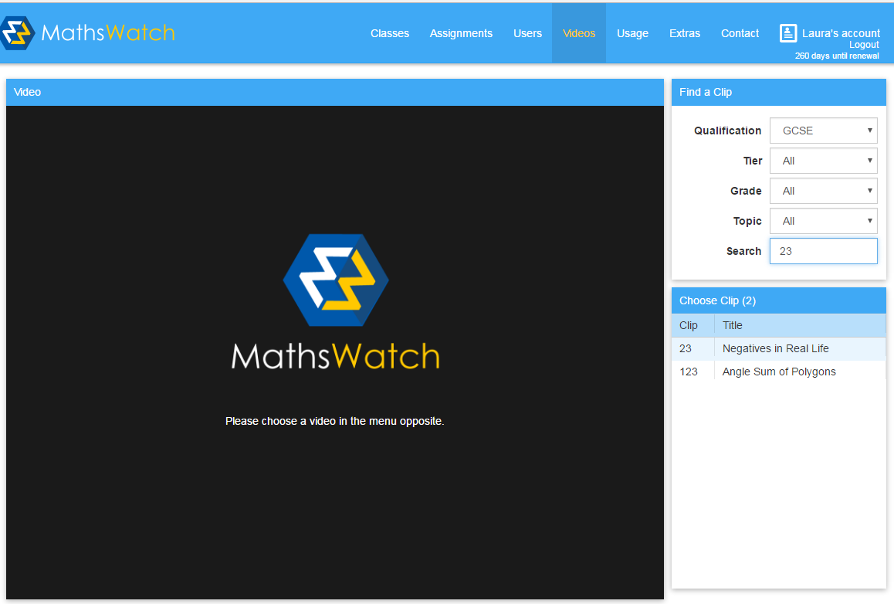
Mathswatch
For all students, you need to log on to vle.mathswatch.com
Your username now has @carrhill at the end of it
so for Mrs Potts rather than lpotts it is lpotts@carrhill
Your password is still numbers
To watch a video:
Click video
Select GCSE
Search for the clip number
Select the one you want to watch

Slide 36
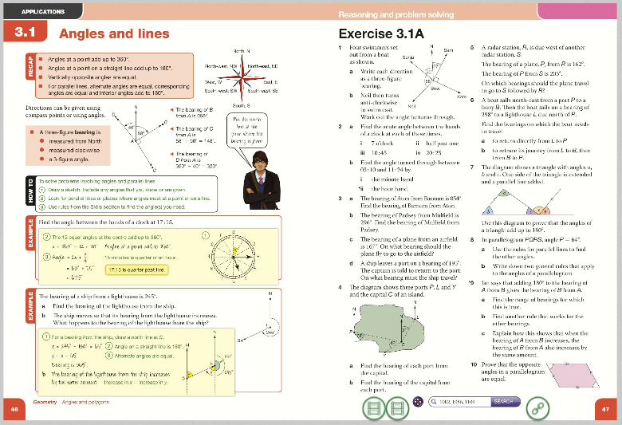
What is Kerboodle?
Notes:
Once we have covered the entire specification we then concentrate on using the assessments to identify each students areas of weakness.
After each assessment the teacher will receive a class report and each individual will receive an individual feedback sheet.
The teacher will initially address any misconceptions and areas of weakness shared by the class and then go onto deal with any individual issues using appropriate resources ( i.e. laptops and computer rooms).
It is essential students take responsibility at this point and take the opportunity to address issues independently maximise their final grade.

Slide 37
What support is available?
Their classroom teacher (at the appropriate time).
Tuesday and Thursday lunchtime room 4.
The Maths office.
Their mentor.
Web based resources.
Notes:
Intervention has already begun and will be changing throughout the year depending on assessment results. When students are timetabled for extra intervention you will be informed.
The intervention days are run throughout the year and have proved to be quite successful.

Slide 38
Useful Web Based Resources Available
Mymaths (login: carr password: isosceles)
Mathswatch (school id: carrhill Login: asmith password: numbers)
Just Maths (User name: CarrStudent Password: Carr)
Kerboodle (Demonstrated in lesson)
The internet
Notes:
Students should know about all these resources and the powerpoint is being made available on the website.
I have put the teacher down as a resource to make it clear that they are more than happy for students to see them outside of lessons with any problems. This does not mean rushing up to them two minutes before lesson because they are struggling with their homework.

Slide 39




Revision Guides

Slide 40
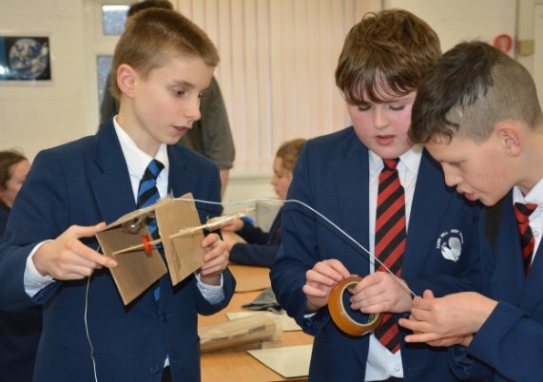
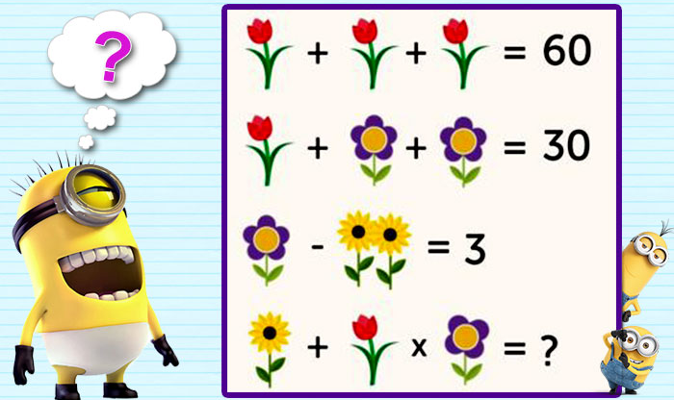
Extra-Curricular Activities
STEM Club (Every Thursday Room 6)
Maths Club (Wednesday Lunch Time)

Slide 41
Positive Attitude
Students’ ideas about their ability and potential are extremely important.
Messages students pick up from their parents about maths can change students’ learning and achievement.
It was not their parents lack of maths knowledge that harmed students’ performance but their parents’ anxiety.
Communicate positive messages, saying that maths is exciting and it is an open subject that anyone can learn with hard work.

Slide 42

Science
Cathy North
Head of Science

Slide 43
Year 8 Structure
Topic | Number of lessons
Unit 8B1 – Organisms (Breathing and Digestion) | (1)8(1)
Unit 8B2 – Ecosystems (Respiration and Photosynthesis) | (1)10(1)
Unit 8B3 – Genes (Evolution and Inheritance) | (1)7(1)
Unit 8C1 – Matter (Periodic Table and Elements) | (1)8(1)
Unit 8C2 – Reactions(Chemical Energy & Types of Reaction) | (1)8(1)
Unit 8C3 – Earth (Climate and Earth Resources) | (1)7(1)
Unit 8P1 – Forces (Contact Forces and Pressure) | (1)8(1)
Unit 8P2 – Electromagnets (Electromagnets & Magnetism) | (1)5(1)
Unit 8P3 – Energy (Work, Heating and Cooling) | (2)6(1)
Unit 8P4 – Waves (Wave Effects and Wave Properties) | (1)5(1)

Slide 44
Year 8 students:
Undertake a Transition examination in the first week which will help us direct intervention where need for Science skills.
Take assessments in pairs of topics to enable them to revise more content each time and develop revision techniques.
Will also undertake an examination towards the end of the year.
Will develop Scientific skills and learn how to think in a Scientific way- Independent research, Investigation, “trial and error”.
Will learn from their mistakes and develop resilience.
Notes:
The first 3 just enable the smooth running of a classroom allowing the teachers to concentrate on the curriculum as much as possible.
The final point I will refer to several times throughout the presentation.
“The one person who has the greatest impact on a students results are the student themselves.

Slide 45
In Science lessons students will:
Do practical work where possible.
Extend and develop Maths skills so will need a calculator.
Meet new words that they will have to remember the meanings of.
Explore the 10 Big ideas about Science through investigation and research.
Experience the kind of questions found in AQA GCSE’s.
Notes:
The first 3 just enable the smooth running of a classroom allowing the teachers to concentrate on the curriculum as much as possible.
The final point I will refer to several times throughout the presentation.
“The one person who has the greatest impact on a students results are the student themselves.

Slide 46
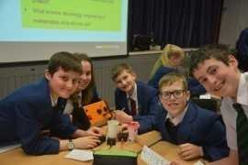
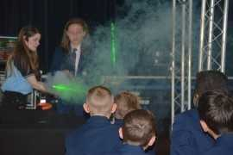
Enrichment Activities
Faraday Challenge
STEM clubs

Slide 47
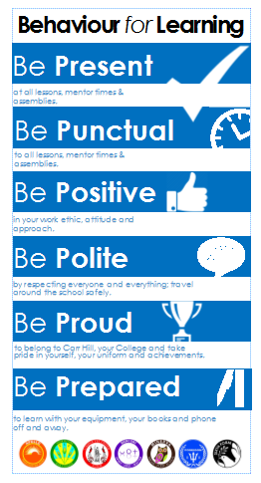
Behaviour For Learning
Lisa Coulthard, Assistant Headteacher

Slide 48
Expectations:

Slide 49
Reward Systems:
  Merits - these are issued on a daily basis to recognise achievement across the school and are recorded on SIMs.
  On a half termly basis student merits will be counted and recognised through College Celebration Assemblies.
  College badges in recognition of annual merit totals .
  Faculty rewards – positive text messages, praise post cards, telephone calls, verbal praise.
  6 ‘P’ Card, which reflects our code of conduct and recognises achievement and behaviour out of the classroom.
  End of year College Celebration Events
  End of year Whole School Celebration Events which takes place at Ribby Hall for invited students.

Slide 50
6 – P Card:
6 P Card – Achievement and conduct out of the class
Each student begins each half term with 10 merits recorded on their ‘P Card’. At the end of a half term these merits will be transferred a students behaviour record and will count towards yearly totals.
These Merits will be entered into a prize draw each half-term, 1 merit = 1 entry.
There will be 2 draws in each College – one for those who have maintained 10 merits and one for those with 6-9 merits
Opportunities will be given to students to earn additional merits
Each half term certificates will be awarded to students based on the number of merits earned on their P Card.
Merits can be earned by getting involved in activities, and by enhancing the life of the school.
Merits be can lost for failing to adhere to our code of conduct outside of the classroom.
There is an expectation that all students will have their card on their person at all times. Failure will result in a College Detention.

Slide 51
Starting Lessons off positively:
In classrooms students must follow this agreed procedure that staff will enforce:
They will enter quietly when instructed to do so
Students stand in silence behind chairs
Wait for teachers instructions
When asked, ensure that they have out all equipment including handbooks.

Slide 52
Consequences of not following instructions:
Lesson Time:
Stage 1 - Formal Warning
Stage 2 – Demerit & Move
Stage 3 – Time Out
Break/Lunch:
Serious Defiance Detentions
Serious Defiance
Exclusion (run from 8.55am – 4pm)
Members of SLT also have the authority to use serious defiance detentions and exclusion where they see appropriate.

Slide 53
We want to all students to have access to a happy and safe learning environment where they can thrive to achieve great success in the future.

Slide 54
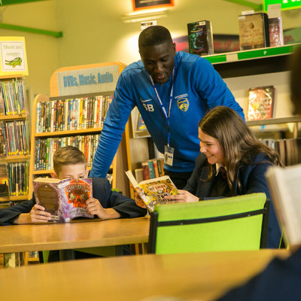
Learning at Carr Hill
Danny Morton
Assistant Headteacher

Slide 55
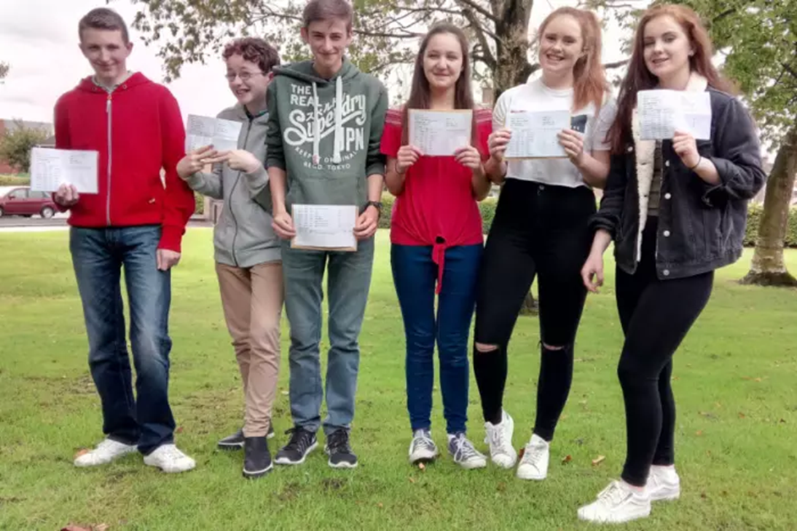
Our Aim Your Aim
Engagement
Challenge
Progression

Slide 56

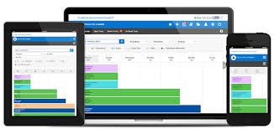
Homework

Slide 57



Feedback

