Slide 1
Year 10 Information Evening
New GCSEs and targets in English and Maths.

Slide 2
English
New GCSEs and targets in English and Maths.

Slide 3
English
There are actually two qualifications:
GCSE English Language (AQA)
GCSE English Literature (AQA)
ALL pupils at Carr Hill will follow a joint programme of study and the vast majority will be entered for both qualifications at the end of two years. They are exam only – no coursework or controlled assessments.

Slide 4
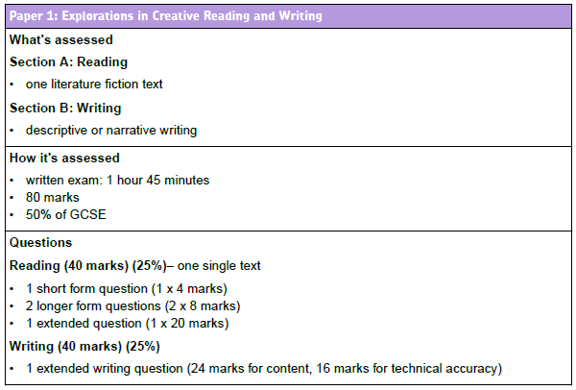
GCSE English Language

Slide 5
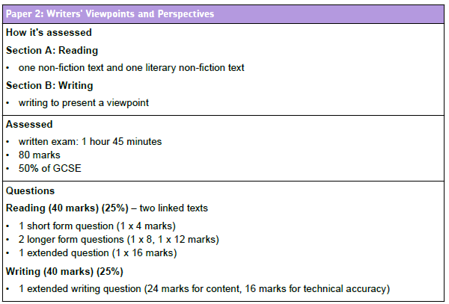
GCSE English Language

Slide 6
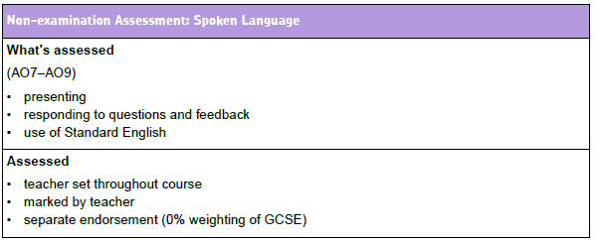
GCSE English Language

Slide 7
GCSE English Literature Paper 1
1 hour 45 minutes.
40 % of Literature GCSE.
Two sections.
Section A – Shakespeare
Includes one extract question and one whole text question.
Section B – The 19th century novel
Includes one extract question and one whole text question.
Slide 32
Copyright © AQA and its licensors. All rights reserved.
Notes:
Point about length of examination within the 4 hours regulation
Stress identity and flow of this paper through the 3 sections
Our determination to offer choice of prose or drama texts – confirm regulation again here
Our commitment to keep unseen texts as two poems
Opportunity here then for teaching of section B to support and inform section B
Our rationale for two comparison activities –
“In each specification as a whole, 20-25% of the marks should require candidates to show the abilities described in AO1, AO2 and AO3 through tasks which require them to make comparisons across texts.”
Must be covered in unseen texts as a minimum
Our strategy to have 2 comparisons recognises it as a higher order skill – 2 goes at it and reduces unnecessary pressure on unseen texts
Our strategy builds on current familiarity of comparing studied poems
Allows choice of poems in section B depending on students’ preferences
Allows teaching and learning in section B (and its resources) to support section C
Following this slide, show the specimen question paper and mark scheme / marking criteria.

Slide 8
GCSE English Literature Paper 2
2 hour 15 minutes.
60% of total Literature marks.
3 sections: modern prose or drama, poetry and unseen texts.
Assesses comparison.
Slide 32
Copyright © AQA and its licensors. All rights reserved.
Notes:
Point about length of examination within the 4 hours regulation
Stress identity and flow of this paper through the 3 sections
Our determination to offer choice of prose or drama texts – confirm regulation again here
Our commitment to keep unseen texts as two poems
Opportunity here then for teaching of section B to support and inform section B
Our rationale for two comparison activities –
“In each specification as a whole, 20-25% of the marks should require candidates to show the abilities described in AO1, AO2 and AO3 through tasks which require them to make comparisons across texts.”
Must be covered in unseen texts as a minimum
Our strategy to have 2 comparisons recognises it as a higher order skill – 2 goes at it and reduces unnecessary pressure on unseen texts
Our strategy builds on current familiarity of comparing studied poems
Allows choice of poems in section B depending on students’ preferences
Allows teaching and learning in section B (and its resources) to support section C
Following this slide, show the specimen question paper and mark scheme / marking criteria.

Slide 9
Our selected literature texts
In Year 10
A Christmas Carol ( Paper 1 – 19th century text)
Animal Farm ( Paper 2 – modern prose)
AQA Conflict themed anthology of poetry (Paper 2 – poetry)

Slide 10
Our selected literature texts
In Year 11:
Macbeth (Paper 1 – Shakespeare)

Slide 11
 | First term - novel ‘A Christmas Carol’
Literature Reading/writing and spoken language skills (below) threaded through literature teaching. | Full first term 19th Century novel Understanding of main themes, characters and ideas Critical response Personal interpretation Use of quotations and close reference to text Key extracts and relate them to the novel Analysis of language Context
Reading | C19th non-fiction texts linked to and to support the text studied for Literature • Identify and interpret explicit and implicit information and ideas • Analysis of how writers use language and structure • Critical evaluation
Writing | Thematic links to texts studied in reading /literature Writing to describe/narrate Teach use of sentence structure and punctuation for effect. Emphasis on crafting writing.
We will teach language and literature side by side.
Pupils will see skills as transferrable.
Although a key writing focus will be addressed each term, other types will still be covered.
Spoken language will be assessed in the second term but will also form an important part of many lessons.

Slide 12
Homework
Pupils will be set both weekly homework and longer project/research based tasks.
As they are closed book examinations, pupils will also be required to re read texts and learn quotes. This is ongoing and may not always be set as the homework for that week – it will be an expected extra.

Slide 13
Texts
Students will be issued with copies of the Literature set texts. They are for use in class.
A Christmas Carol
Animal Farm
Macbeth
Texts are also available on Moodle.
Should you wish to purchase texts so that your child can complete additional revision at home, details of editions are on your handouts.

Slide 14
Interventions
There are already intervention sessions starting this week for students identified at the end of Y9.
All pupils’ progress will be continually monitored and appropriate measures put into place as soon as possible.

Slide 15
There is a handout available but should you have any cause for concern or need any further information, please contact either:
Adele McDonough - Director of Learning
Christina Fry – Assistant Director of Learning
Kathryn Gardner – Assistant Director of Learning

Slide 16
Mathematics
New GCSEs and targets in English and Maths.

Slide 17
GCSE Mathematics
The volume of subject content has increased.
The demand of that content is increasing too, with harder topics being introduced.
The total time for the examinations is increasing, from 3 ½ hours to 4 ½ hours.
In the assessments there’s a greater emphasis on problem solving and mathematical reasoning, with more marks now being allocated to these higher-order skills.
Students will be required to memorise formulae – fewer formulae will be provided in examinations

Slide 18
Topics New to Foundation Tier
GCSE Mathematics
Standard form
Factorising quadratics
Linear simultaneous equations
Trigonometry
Compound interest
Reverse percentages
Circle properties
Vectors
Direct and inverse proportion

Slide 19
Foundation Tier
GCSE Mathematics

Slide 20
Topics New to Higher Tier
GCSE Mathematics
Expanding binomials
Gradient at a point on a curve as rate of change
Areas under graphs
APs and GPs
Finding approximate solutions using iteration
Solving quadratic inequalities
Inverse and composite functions

Slide 21
Higher Tier
GCSE Mathematics

Slide 22
GCSE Mathematics
 | Assessment Objectives | F | H
AO 1 | Use and apply standard techniques | 50% | 40%
AO 2 | Reason, interpret and communicate Mathematically | 25% | 30%
AO 3 | Solve problems within Mathematics in other contexts | 25% | 30%

Slide 23
Grading
GCSE Mathematics

Slide 24
Assessment
GCSE Mathematics
Skills

Slide 25
Support
GCSE Mathematics
Teaching time increased (8 hours per fornight)
New teaching and support resources
Adapted scheme of work
Adapted in class assessment and feedback
Revision guides
MathsWatch
Kerboodle
MyMaths
Drop in sessions
Targeted intervention and revision sessions

Slide 26
Targets
GCSE Mathematics

Slide 27
There is a handout available but should you have any cause for concern or need any further information, please contact either:
Bernadette Taylor - Director of Learning
Laura Potts – Assistant Director of Learning
James Myers – Assistant Director of Learning

Slide 28
Targets
New GCSEs and targets in English and Maths.

Slide 29
New GCSE grades
Graded from 9-1, replacing A*-G grades
Grade 9 will be highest
Grade 5 will be considered a good pass, equivalent to a current low B or high C. It will be linked to standards in high performing countries
Grade 4 will be equivalent to current low C grade
Grade 1 will be lowest
Introduced for new-style GCSEs in English and maths to be taught from September 2015
First of new exam grades awarded summer 2017
All other current GCSEs will remain A*-G

Slide 30
Above Average School
KS2 |  | KS3 |  |  | KS4 |  | GCSE Target
KS2 Level | KS2 Fine Level (Reading & Maths) | Year 7 Target | Year 8 Target | Year 9 Target | Year 10 Target | Year 11 Target | New GCSE Target Grade | Old GCSE Target Grade
6/5 | >= 5.8 | 4 | 6 | 7 | 8 | 9 | 9 | A*/A*+
5 | 5.4 - 5.7 | 3 | 5 | 6 | 7 | 8 | 8 | A+/A*-
5/4 | 4.9 - 5.3 | 3 | 4 | 5 | 6 | 7 | 7 | A-/A
4 | 4.5 - 4.8 | 2 | 3 | 4 | 5 | 6 | 6 | B/B+
4/3 | 4.0 - 4.4 | 1 | 2 | 3 | 4 | 5 | 5 | B-/C+
3 | 3.3 - 3.9 | W3 | 1 | 2 | 3 | 4 | 4 | C-/C
3/2 | 2.0 - 3.2 | W2 | W3 | 1 | 2 | 3 | 3 | D
1 | <= 1.5 | W2 | W3 | 1 | 1 | 2 | 2 | E
1 | <= 1.5 | W1 | W2 | W3 | 1 | 1 | 1 | F
1 | <= 1.5 | W1 | W2 | W3 | 1 | 1 | 1 | G

Slide 31
Keeping track of progress
Flight paths
Tracks progress against targets
Find it on the first page of exercise books

Slide 32
Reports
Grade and confidence level
Maths and English – new grades and confidence levels
All other subjects – old style grades and confidence levels
Moodle or paper copy
December, February, April and July

Slide 33
Questions?
New GCSEs and targets in English and Maths.

