Slide 1
CARRHILL CHROMEBOOK
ROLLOUT

Slide 2
CHROMEBOOK Enrolment
Keep Quiet
Follow the instruction in this PowerPoint. Do not jump ahead.
You will receive a lot of information in a very short time

Slide 3
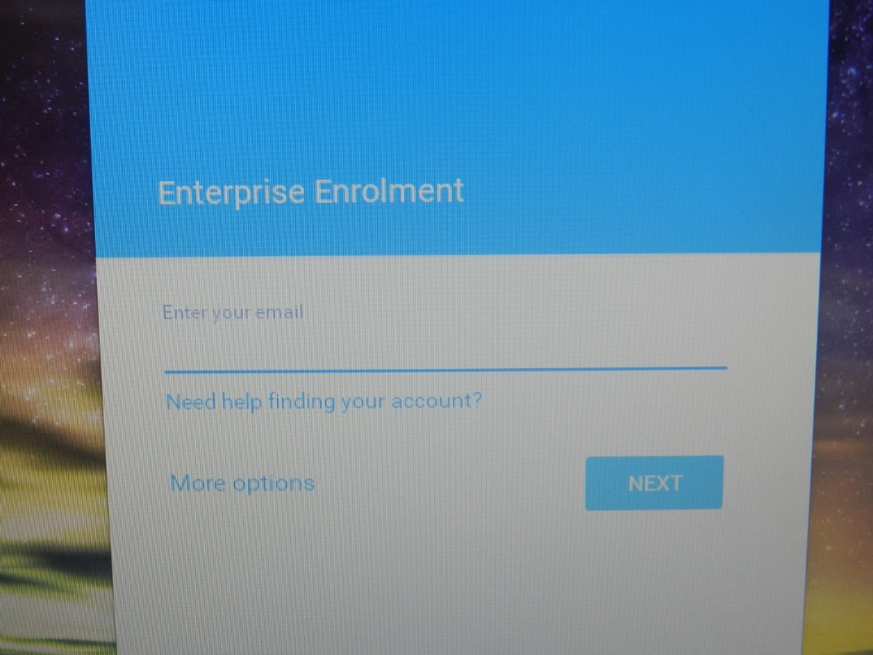
Enrolment
You must now Press Ctrl+Alt +E
You will now see this screen

Slide 4
Enrolment
You must now enter your school email address in the following format
username@carrhill.lancs.sch.uk
Now enter your password

Slide 5
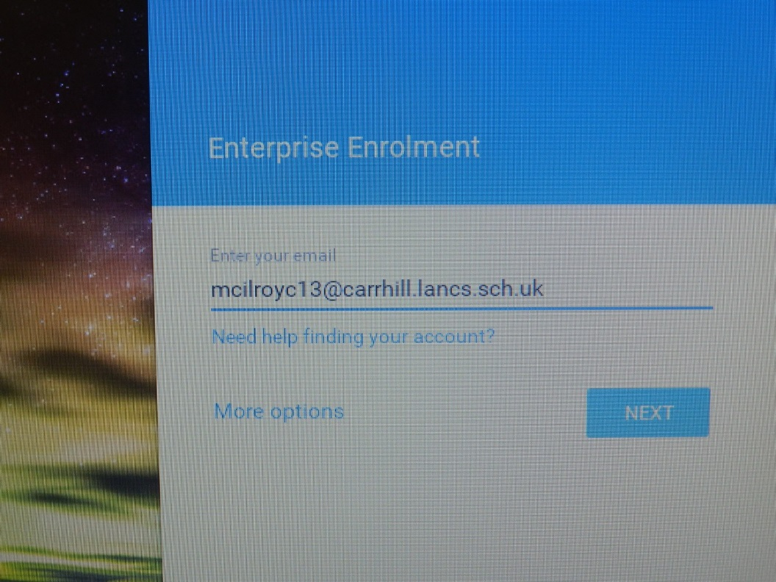
Enrolment
Enter email address here
Enter password here

Slide 6
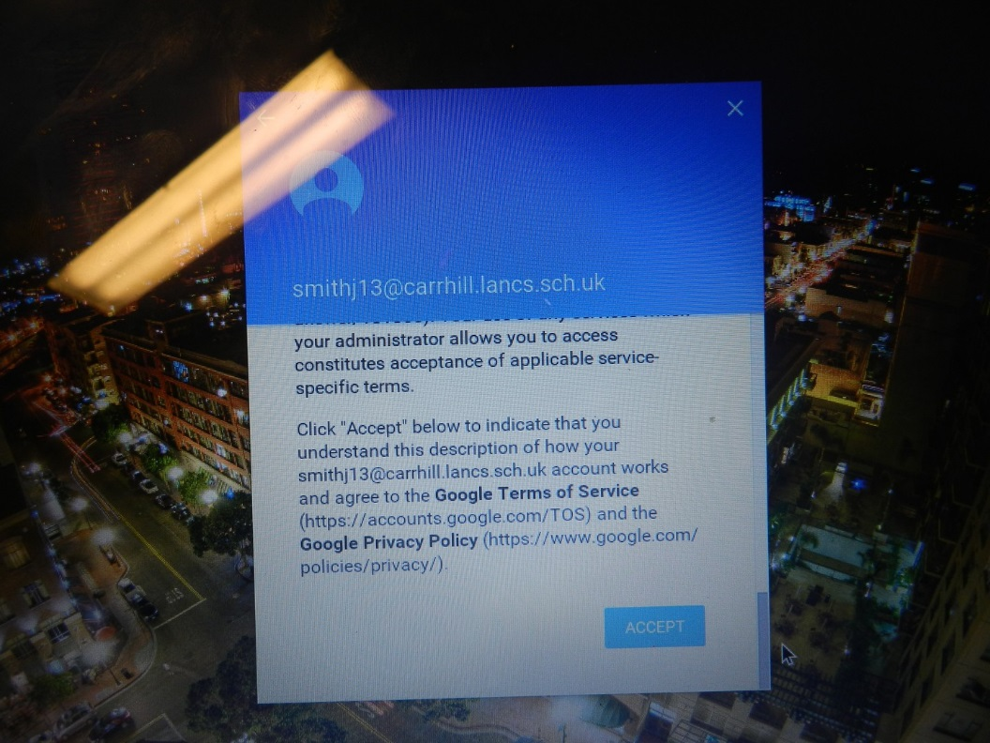
Enrolment
Once you have entered your email and password the next screen you will see is the terms and conditions scroll to the bottom and accept the terms and conditions.

Slide 7
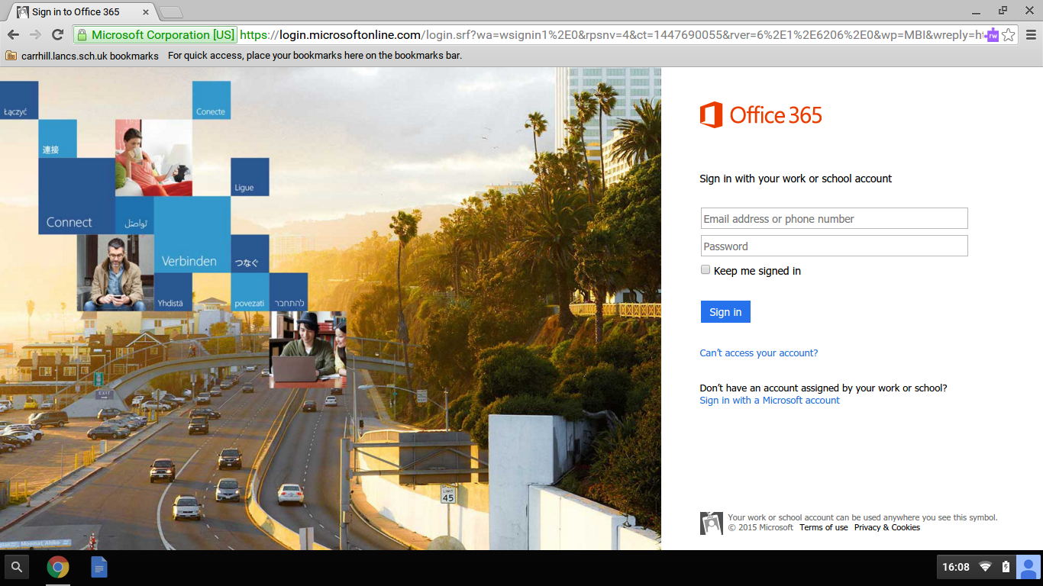
Enrolment
Ensure that you click on the finished box that appears.
You may have to enter your email and password up to 3 times this is normal. You are now enrolled.
You will be directed automatically to your Office 365 email page, login to this page.

Slide 8
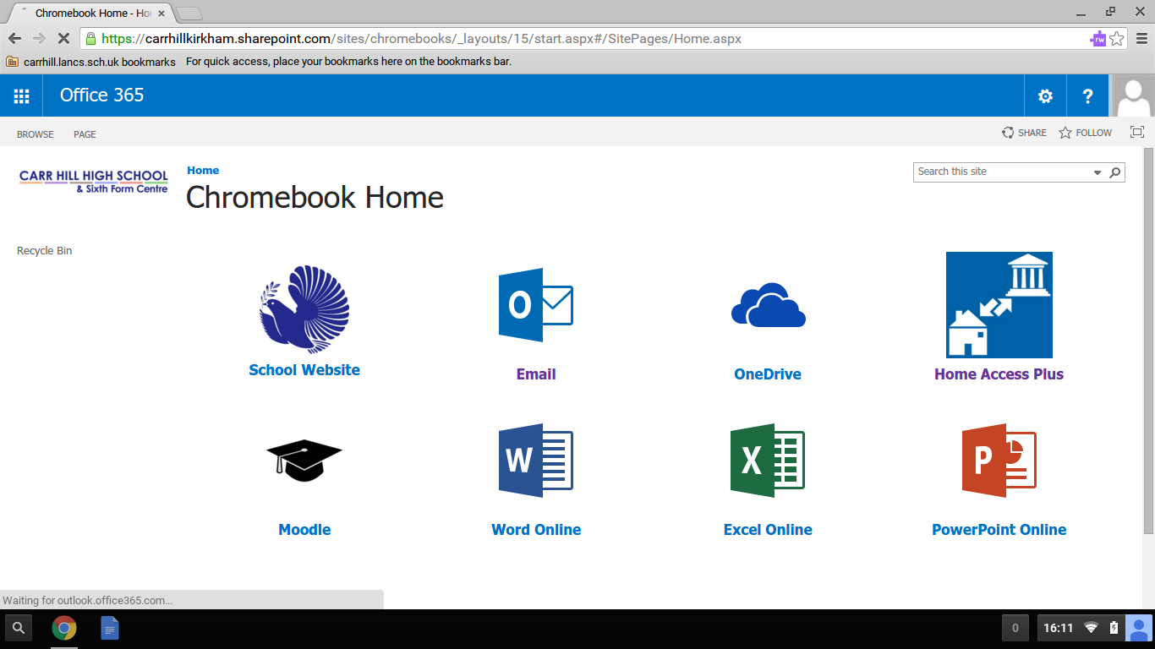
Using Your Chromebook with the web apps
As Soon as you log in to your email page you will be directed to this page
On this page are all of the online services that the school uses and you will be using on your Chromebook

Slide 9
Adding a printer to your Chromebook
We will now need to add the printer to your Chromebook
Press on this icon top right corner of the screen under the X and then select PRINT

Slide 10
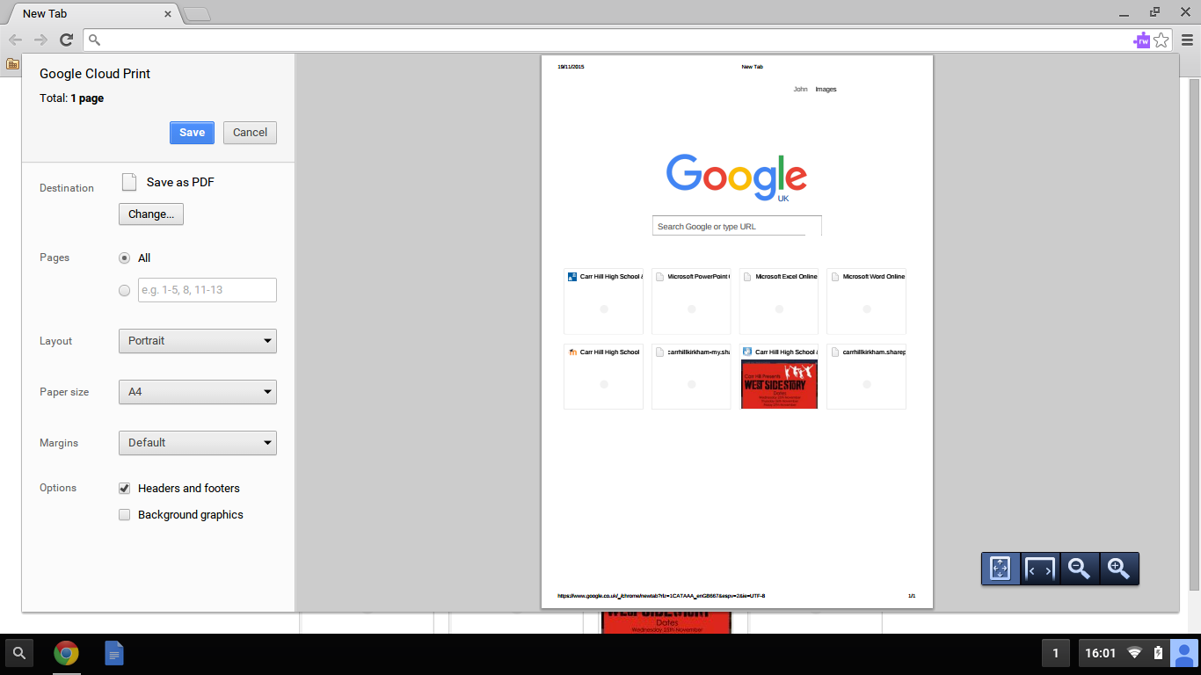
Adding a printer to your Chromebook
You will now see this page
Click on the change button

Slide 11
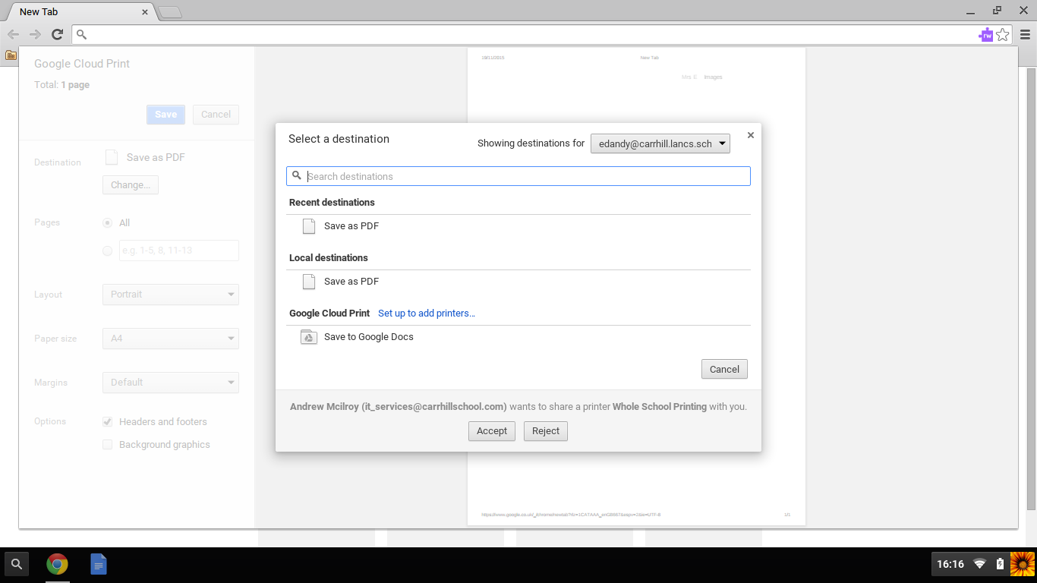
Adding a printer to your Chromebook
You will see this window with a invitation from Andrew Mcilroy wants to share a printer whole school printing with you .
Press accept. You now have access to whole school printing.
This works in the same way as the school printers you send the job to the printer then go and release it on any printer in the school.
You can also add your home printer to this see webpage on school website for information on how to do this.

Slide 12
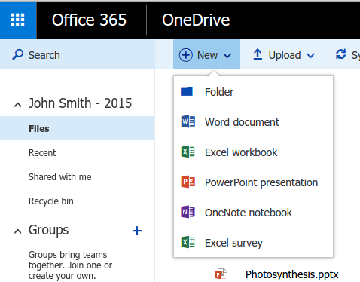
Chromebook Task
Ensure that you are on the Chromebook home page. If you are not on this page you can get to it using the bookmarks here
Once on the page open one drive. Create the following Folders; English, Maths, Science.
After creating the folders. Login to HAP+ download any file from your area and then upload it into OneDrive

Slide 13
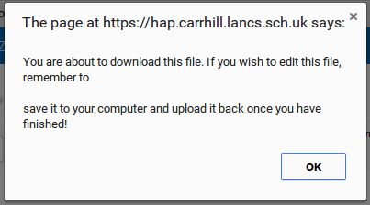
Chromebook Task

Slide 14
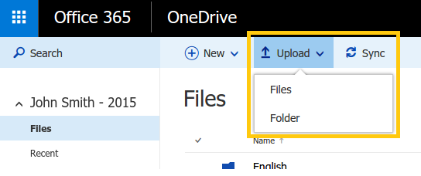
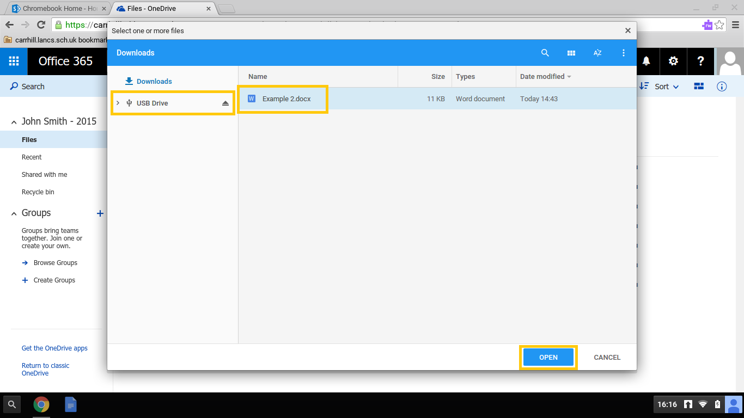
Chromebook Task
Now minimise HAP+
Open OneDrive open the maths folder and upload the file to the maths folder.

Slide 15
Chromebook Task
You have now uploaded the file to OneDrive.
Open the file now you will be able to work on the file in word, excel, PowerPoint, online.
For further information check out the Chromebook page on the school website, Also the students help page on Moodle in the Students Area.

